Slide 1
Opportunities in Highway Transportation
All photos source: FHWA.
Machine Learning in Science and Engineering
David Kuehn
Exploratory Advanced Research Program Manager
Federal Highway Administration (FHWA)
December 15, 2020

Slide 2
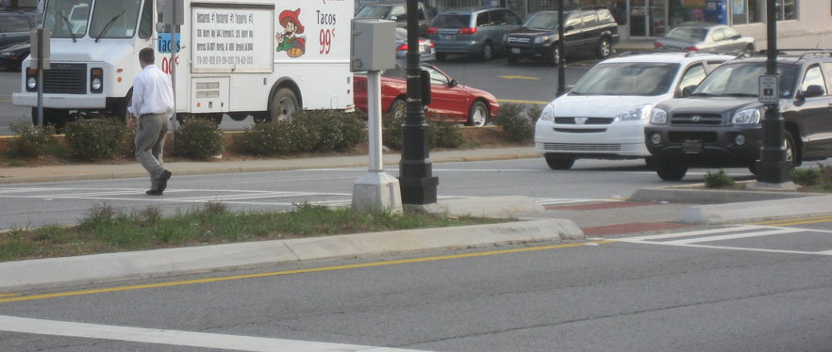
What is Artificial Intelligence?
Artificial Intelligence (AI) consists of the thoughts and conclusions that computers make after receiving data inputs.
© 2020 David Kuehn
Notes:
Definition from https://www.fhwa.dot.gov/publications/research/ear/18066/18066.pdf
I took the photo. It shows a person in a crosswalk in Atlanta, GA.

Slide 3
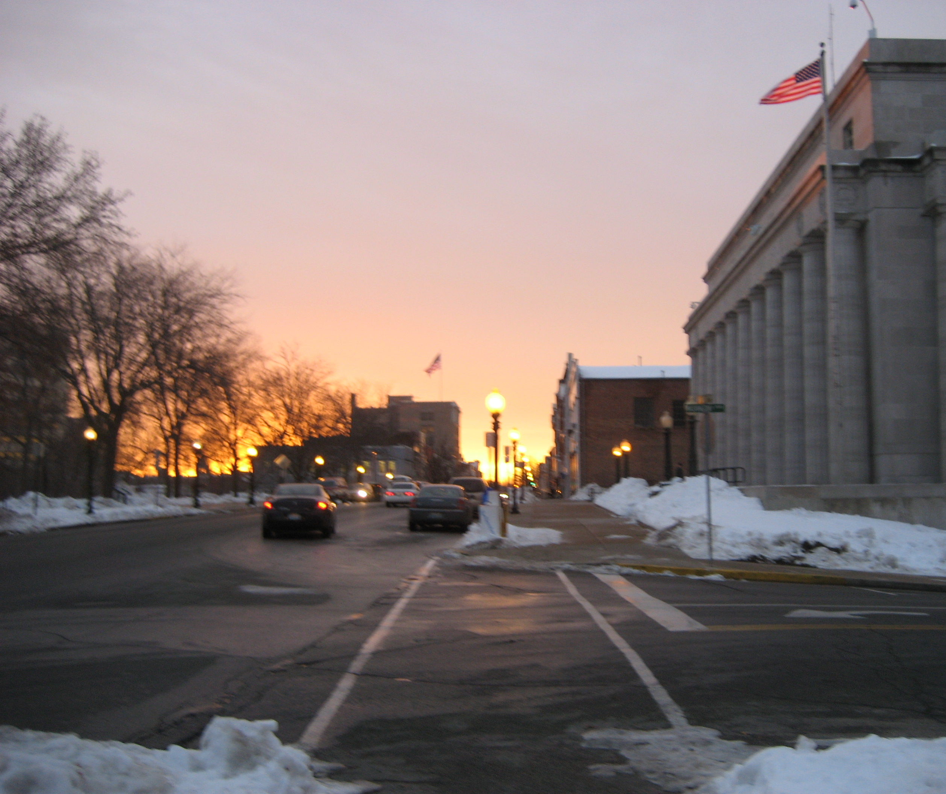
Why is FHWA Interested in AI? And why Now?
Government interest
  System benefits
    Safety
    Mobility
    Asset conditions
  Vulnerable travelers
Enabling technologies
  Computer processing, storage
  New data: real-world and synthetic
  Communications networking
© 2020 David Kuehn
Notes:
I took this photo. It shows traffic on a street with sidewalks cleared of snow in Jefferson City, MO.

Slide 4
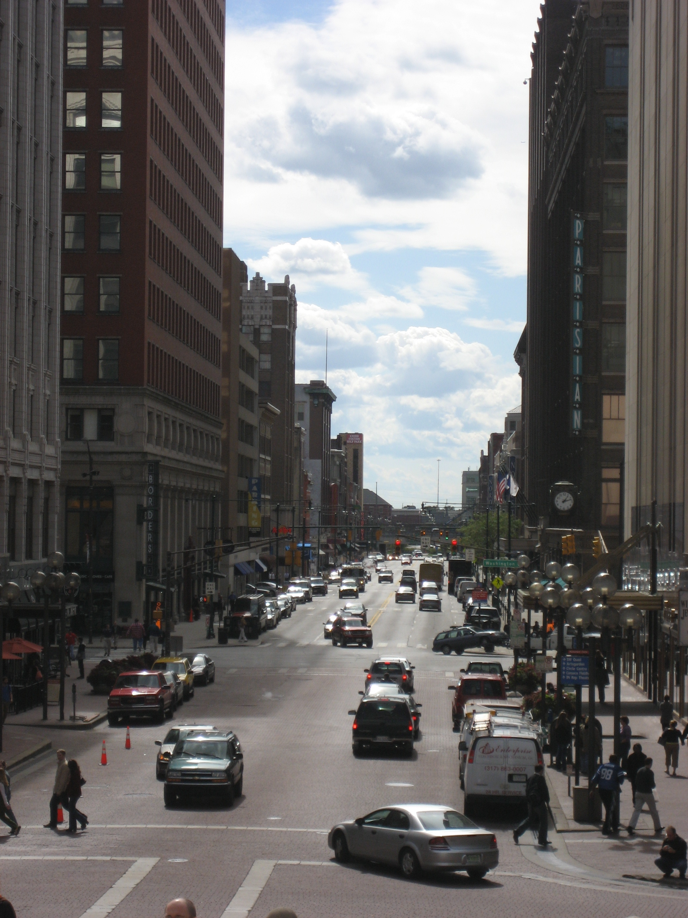
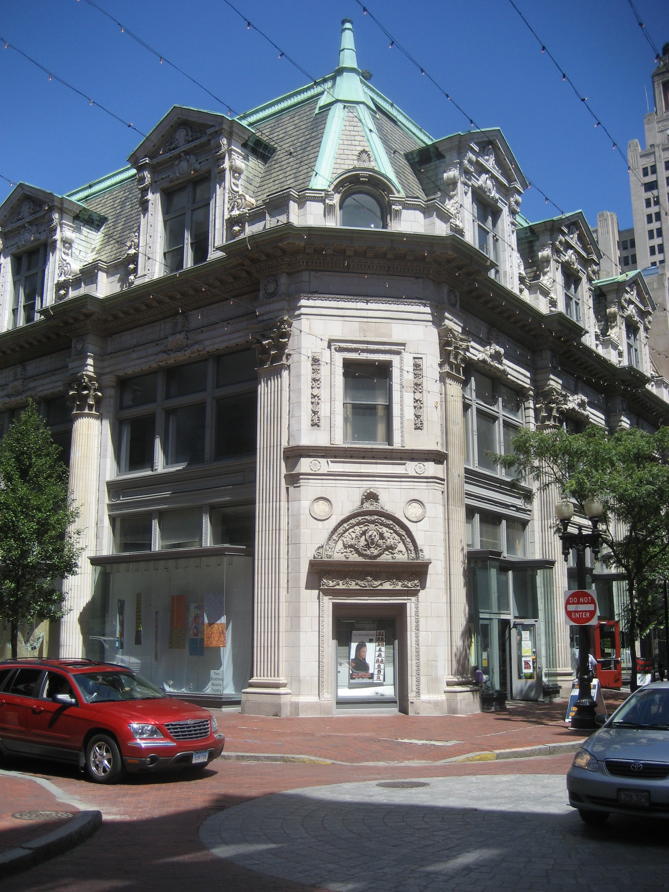
WHAT AI WORK IS FHWA FUNDING?
Computer Vision
Analyze driver behavior in the Strategic Highway Research Program 2 Naturalistic Driving Study
Provide facial privacy for study participants
Automate roadway feature detection, classification
Find more information at www.fhwa.dot.gov/publications/research/ear/18066/18066.pdf
© 2020 David Kuehn
© 2020 David Kuehn
Notes:
I took these photos. The photo on the left is vehicle and pedestrian traffic on a street in downtown Indianapolis, IN. The photo on the right is of an intersection with colored pavement in Providence, RI.

Slide 5
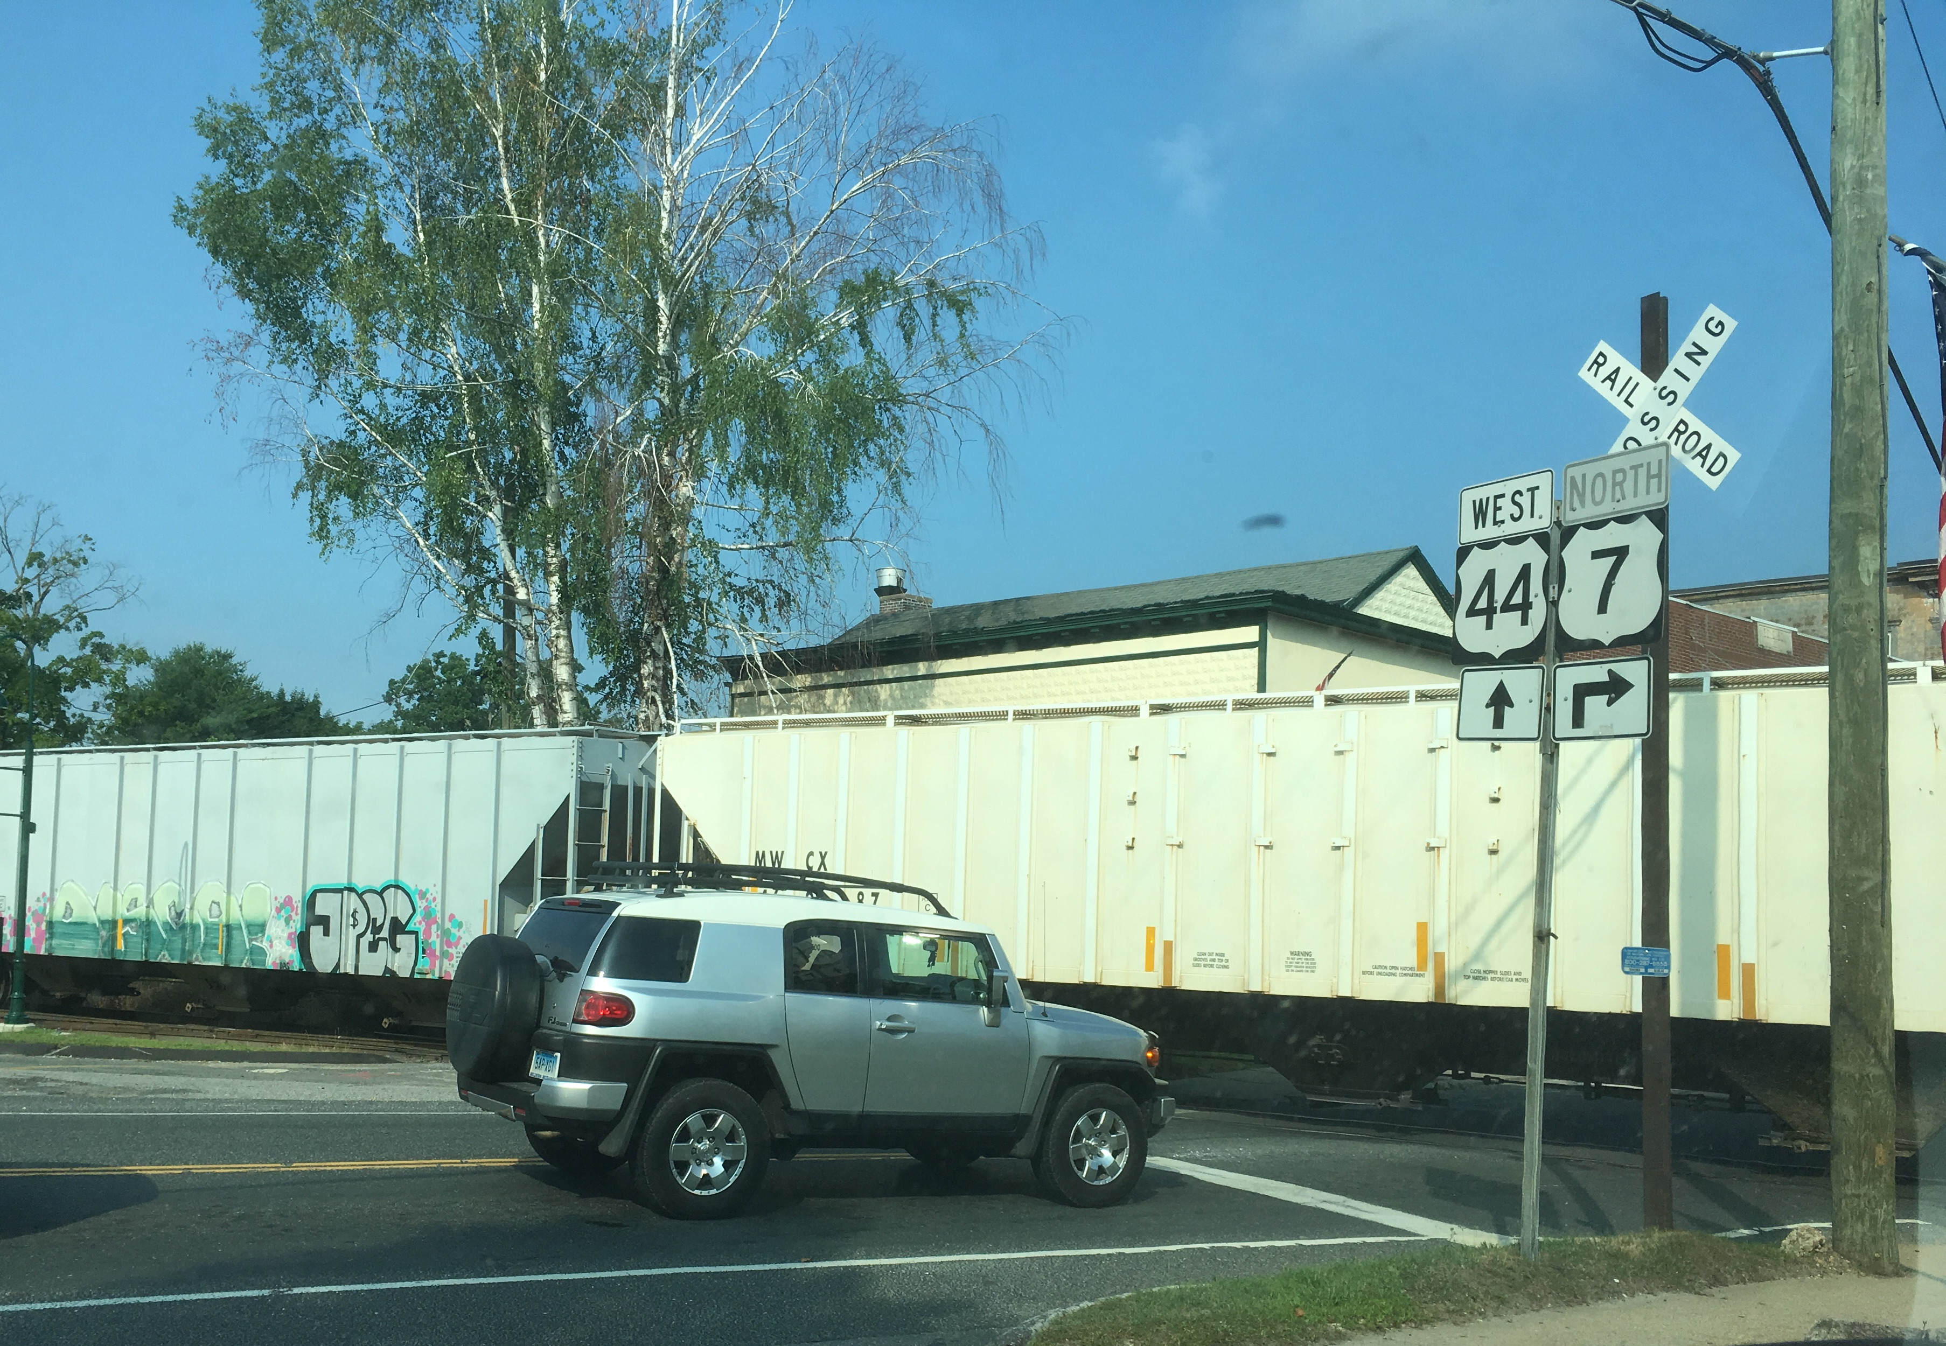
WHAT AI WORK is FHWA Funding?
DATA INFERENCE
Unstructured data: Crash reports, traffic, weather
Natural language processing
More information at www.fhwa.dot.gov/publications/research/ear/18066/18066.pdf
© 2020 David Kuehn
Notes:
I took this photo of a vehicle stopped at a railroad crossing with freight cars in the crossing in Canaan, CT.

Slide 6

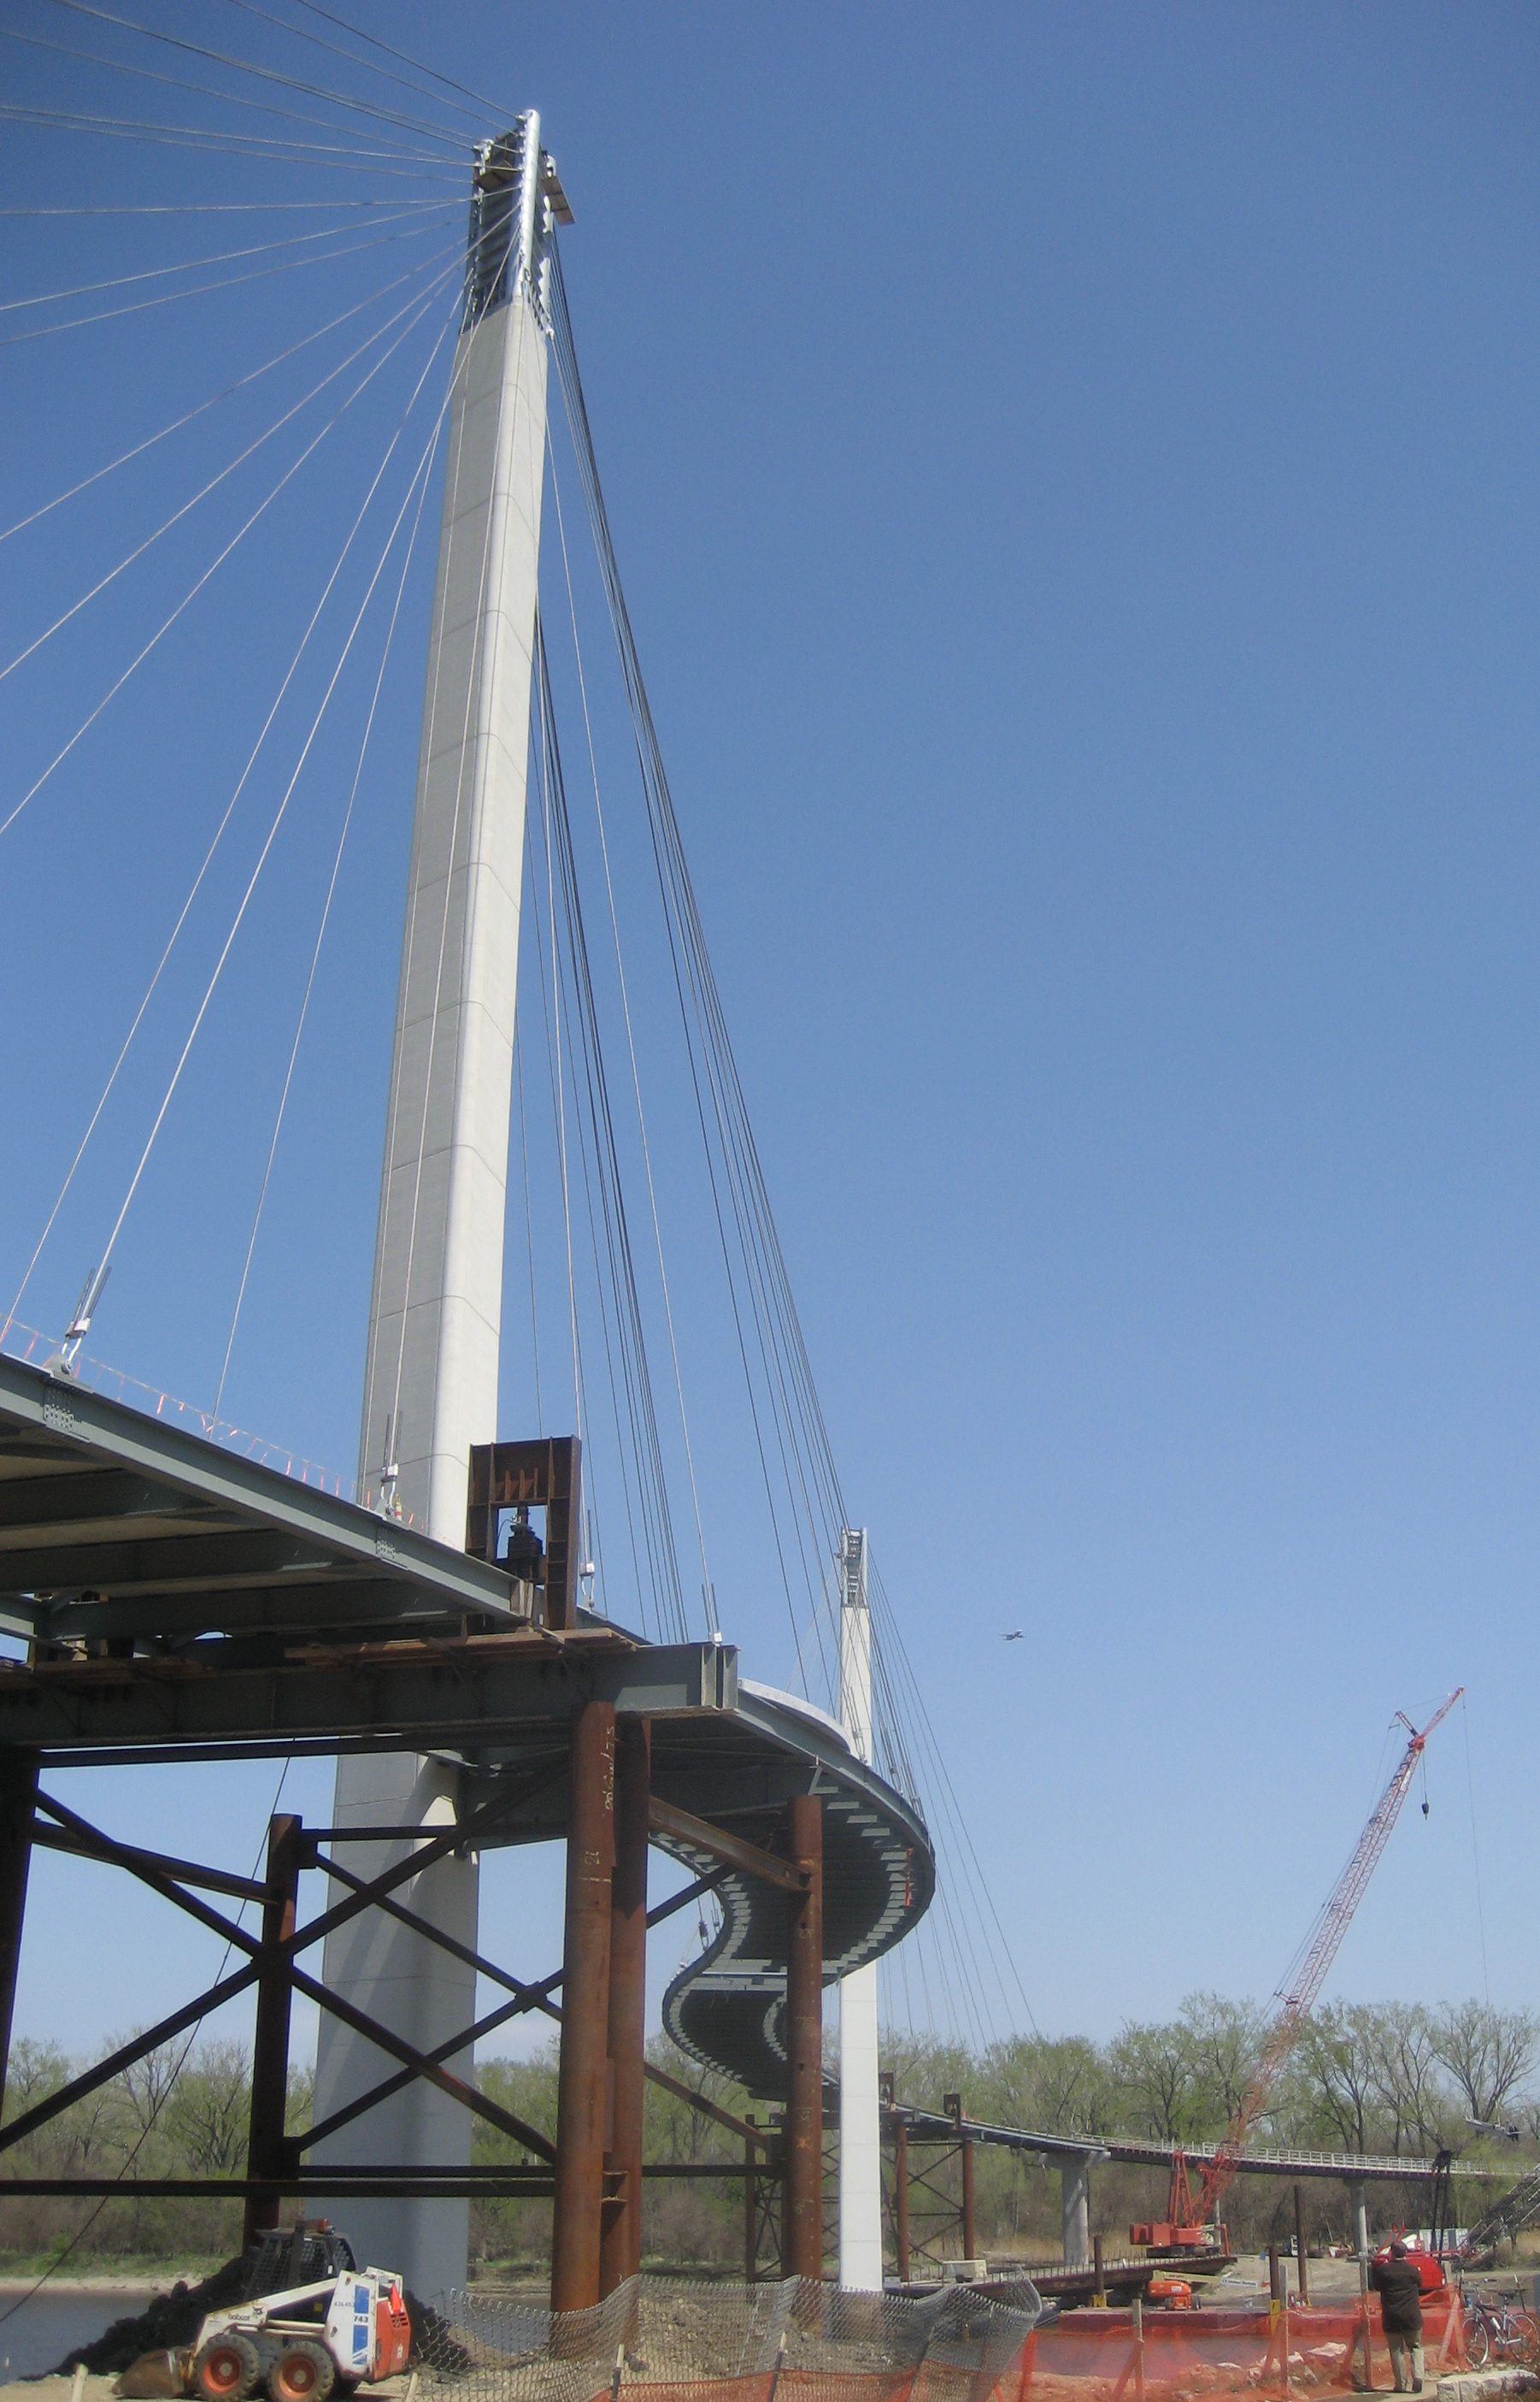
WHAT AI WORK is FHWA Funding?
PREDICTING COMPLEX RELATIONSHIPS
Structural sensor system data
Materials data
More information at www.fhwa.dot.gov/publications/research/ear/20048/20048.pdf
© 2020 David Kuehn
© 2020 David Kuehn
Notes:
I took these photos. The photo on the left is part of a bridge in Irvine, CA. The photo on the right is a bridge under construction in Omaha, NE.

Slide 7
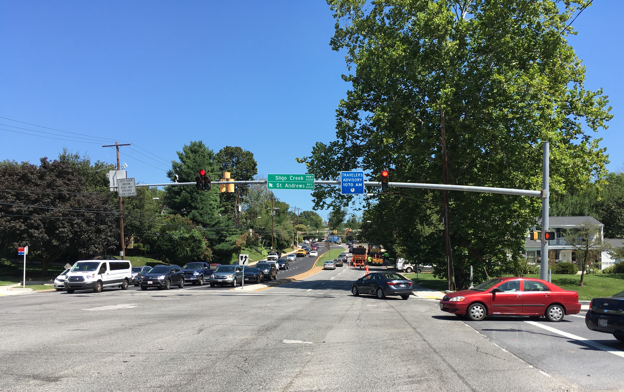
FHWA WORK ACROSS GOVERNMENT
National AI Research and Development Strategic Plan
National Science Foundation AI Institutes: Fundamental and use-inspired research
© 2020 David Kuehn
Notes:
I took this photo of vehicles crossing a signalized intersection in Silver Spring, MD.

Slide 8
WHAT are future challenges?
Integrate traditional and nontraditional highway data to better explain and predict system performance.
Significantly increase the ability to process data by reducing or eliminating the need for manual data preprocessing and the need for hard-to-find expertise.
Improve sensor signal data to assess current conditions of pavements and structures.
Provide decision support to assist experts in the design, operations, and management of highway systems.

Slide 9
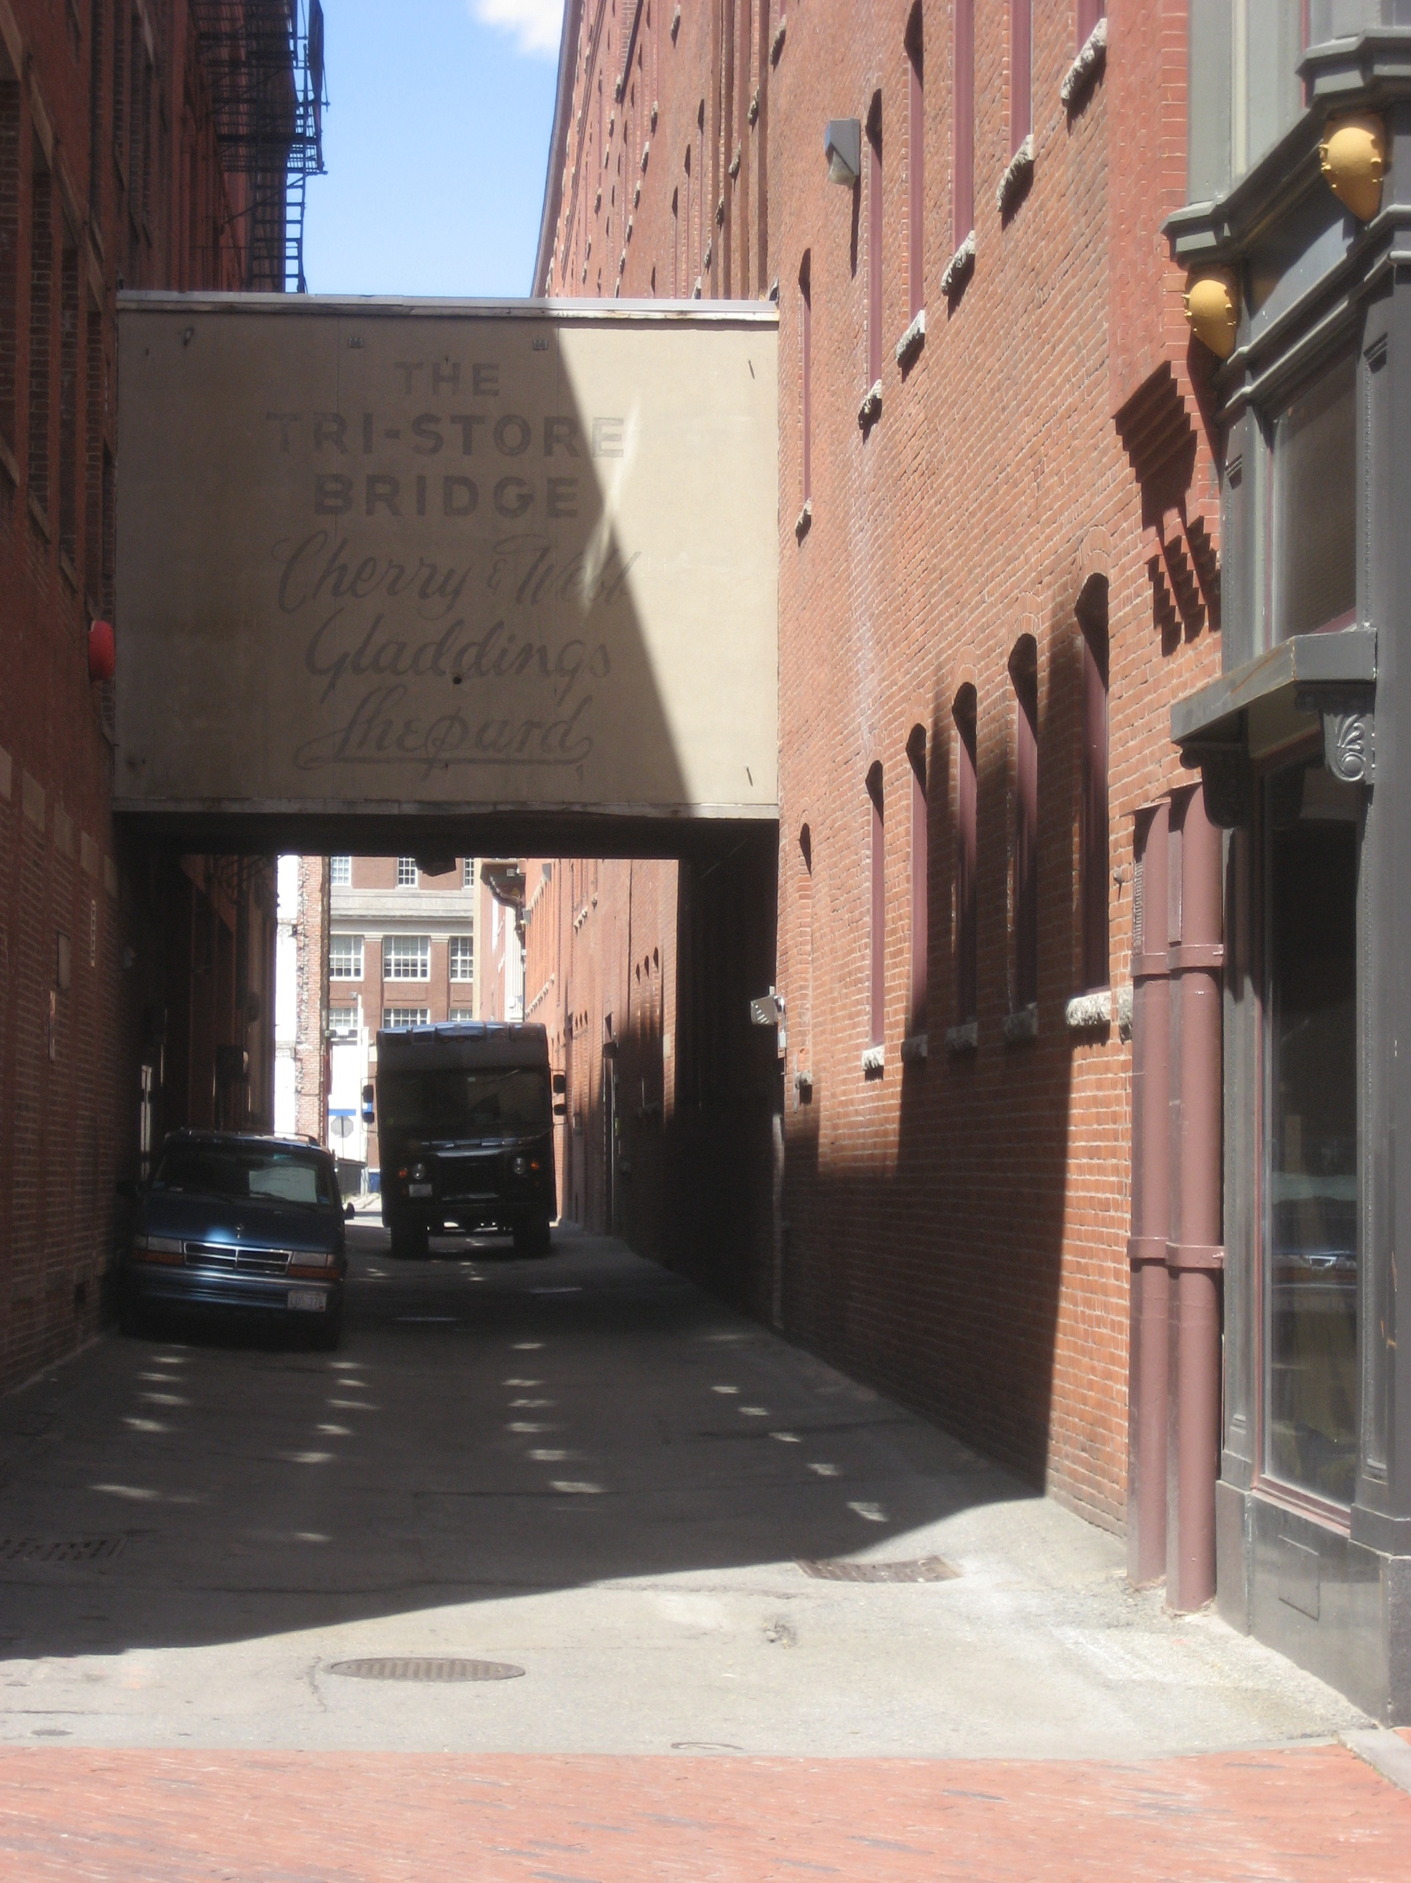
Transition to practice
Sharing resources
  Annotated data for training, testing
  Tool libraries
  Practices for effective workflows
Working with asset owners, industry
  Integration with legacy systems
  Supporting agency decisionmaking
  Scaling implementation
© 2020 David Kuehn
Notes:
I took this photo of an alley with a parked car and truck and a second story enclosed walkway between two buildings above the alley in Boston, MA.

Slide 10
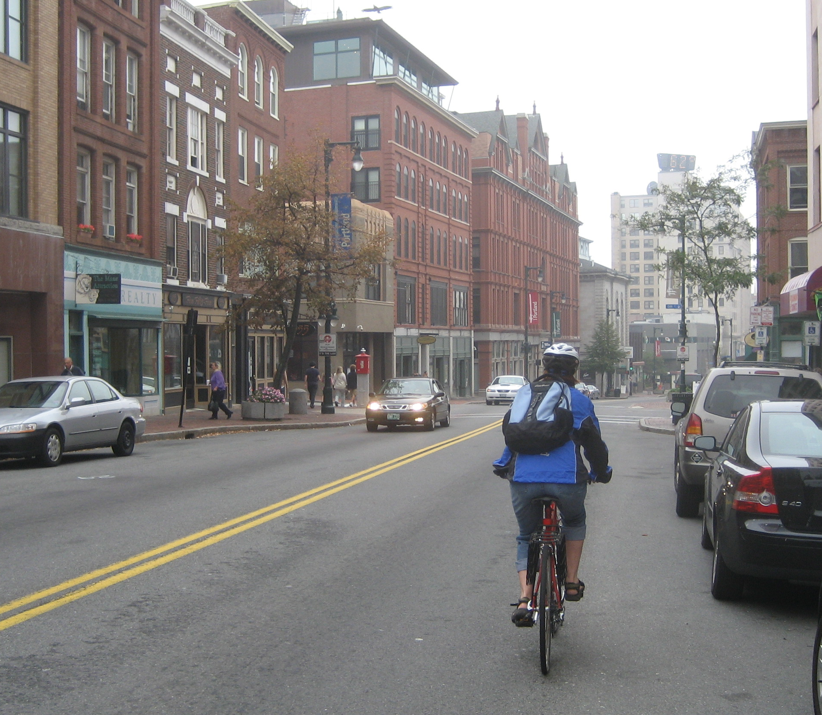
Questions
© 2020 David Kuehn
Notes:
I took this photo of a cyclists riding along parked cars in Portland, ME.

Slide 11
The U.S. Government does not endorse products or manufacturers. Trademarks or manufacturers’ names appear in this presentation only because they are considered essential to the objective of the presentation. They are included for informational purposes only and are not intended to reflect a preference, approval, or endorsement of any one product or entity.

Slide 12

CONTACT
David Kuehn
Program Manager
David.Kuehn@dot.gov
Source: FHWA.

