Slide 1
EQUITY
& The
SAFE SYSTEM
APPROACH
Zero is our goal. A Safe System is how we get there.

Slide 2
Note to presenters
This presentation was developed for FHWA staff to provide information on considerations to Integrate Equity into the Safe System Approach (SSA). Future updates will include how Equity integrates into all elements of SSA.
Others are welcome to use it in whole or in part as appropriate to their purposes.
Thank you.

Slide 3
Disclaimers
Except for any statutes or regulations cited, the contents of this presentation do not have the force and effect of law and are not meant to bind the public in any way. This presentation is intended only to provide information regarding existing requirements under the law or agency policies.
The U.S. Government does not endorse products, manufacturers, or outside entities. Names/logos appear in this presentation only because they are considered essential to the objective of the presentation. They are included for informational purposes only and not intended to reflect a preference, approval, or endorsement of any one product or entity.
Unless noted otherwise, FHWA is the source for all images in this presentation.

Slide 4
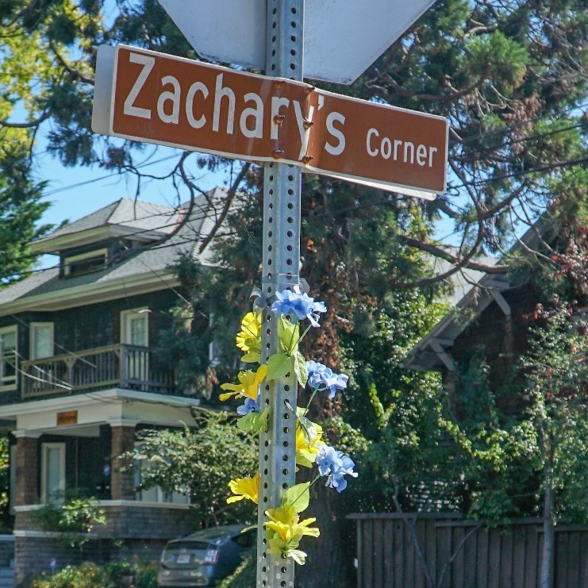
IMAGINE OUR COUNTRY AS A PLACE WHERE NOBODY HAS TO DIE FROM VEHICLE CRASHES.
Source: Fehr & Peers
Notes:
Key Message: Before we get started, let’s take a moment to reflect on the reason we are here today: each day, people are killed and seriously injured on our roads. Crashes can irreversibly change the course of human lives, touching victims, their families and loved ones, and society as a whole. These deaths and serious injuries disproportionately impact underserved communities. But death and serious injury do not have to be consequences we live with simply to use our roadway system. And a person should not be more likely to be killed because of where they live. Through collective action on the part of all roadway system stakeholders—from system managers and vehicle manufacturers, to engineers, planners, and everyday users—we can move to a Safe System approach that first anticipates human mistakes and second keeps impact energy on the human body at tolerable levels—with the goal of eliminating fatal & serious injuries for all road users. This presentation gives an overview of how Equity integrates into the Safe System approach.
Interactivity: Ask the audience how familiar they are with the Safe System approach. What Safe System practices are they implementing or planning to implement in their communities?
Background: The Safe System approach is a global movement that has been in place in countries across the globe for more than 30 years. The Federal Highway Administration’s (FHWA) top priority is safety, and for this reason it fully supports the vision of zero deaths and serious injuries on the Nation’s roadway system. While the Safe System approach is new to the United States, it is worth mentioning that the majority of the States have adopted a zero deaths approach (also known as Toward Zero Deaths (TZD)), and more than 50 communities across the United States have adopted Vision Zero initiatives that set a goal of eliminating fatal and serious injuries from the roadway system. TZD and Vision Zero provide opportunities to adopt Safe System, and some States and localities have already adopted the Safe System approach.
Notes: Additional information on the FHWA Safe System approach is available at https://safety.fhwa.dot.gov/zerodeaths/

Slide 5
PRESENTATION OVERVIEW
1
2
3
4
5
US DOT Equity Action Plan
Equity in the Safe System Approach
Equity in the Safe System Principles
Equity in the Safe System Elements
Conclusion & Resources
Notes:
Key Message: The presentation begins with an overview of Equity, US DOT’s Equity Action Plan and policies and programs that support the goal of reducing inequities across our transportation systems and the communities they affect. The next sections address the intersection of inequities and the traffic safety problem and provides information on the principles and elements that make up the Safe System approach. The presentation then expounds how equity integrates into each Safe System Principle and delves into specific strategies to fortify the Safe Roads element. Future updates to this presentation will incorporate how equity integrates into the four other elements. The presentation concludes with additional resources that you can use to help bring Equity and the Safe System approach to your community.
Interactivity: Before moving into Section 1 on the next slide, do any attendees have questions at this point?
Background: No background for this slide.
Notes: The presentation has 5 sections. Equity in the Safe System Principles and Equity in the Safe System Elements are the longest sections, and the presentation typically takes between 30 and 45 minutes.

Slide 6
Presentation Overview
1
2
3
4
5
Equity in US DOT and FHWA
Equity in the Safe System Approach
Equity in the Safe System Principles
Equity in the Safe System Elements
Conclusion & Resources

Slide 7
EQUITY
The consistent and systematic fair, just, and impartial treatment of all individuals, including individuals who belong to underserved communities that have been denied such treatment (EO 13985)
Source: USDOT
Notes:
Key Message: For the first time, DOT has centered Equity as a Department-wide strategic goal. This is a critical step to institutionalizing equity across the Department’s policies and programs, with the aim of reducing inequities across our transportation systems and the communities they affect.
Interactivity: No interactivity for this slide.
Background: In response to Executive Order 13985: Advancing Racial Equity and Support for Underserved Communities Through the Federal Government, this Equity Action Plan highlights key actions that USDOT will undertake to expand access and opportunity to all communities while focusing on underserved, overburdened, and disadvantaged communities. The actions described here fall under four focus areas – wealth creation, power of community, interventions, and expanding access. Actions include providing technical assistance to small disadvantaged businesses, reinvigorating USDOT’s programmatic enforcement of Title VI of the Civil Rights Act, launching a national technical assistance center, and developing a national transportation cost burden measure. These actions were developed through an intensive effort, combining knowledge, experience, viewpoints, and data from the public, experts, and USDOT staff.
Notes: Executive Order On Advancing Racial Equity and Support for Underserved Communities Through the Federal Government
(EO 13985) is available at https://www.whitehouse.gov/briefing-room/presidential-actions/2021/01/20/executive-order-advancing-racial-equity-and-support-for-underserved-communities-through-the-federal-government/. US DOT’s Equity Action Plan is available at https://www.transportation.gov/priorities/equity/equity-action-plan.

Slide 8
Underserved Communities
Black, Latino, Indigenous, Native American, Asian, Pacific Islanders, and other persons of color (BIPOC)
Members of religious minorities
Lesbian, gay, bisexual, transgender, and queer (LGBTQ+) persons
Persons with disabilities
Persons who live in rural areas
Persons otherwise adversely affected by persistent poverty or inequality
Populations sharing a particular characteristic, as well as geographic communities, that have been systematically denied a full opportunity to participate in aspects of economic, social, and civic life. (EO 13985)
Source: USDOT
Notes:
Key Message: Underserved Communities are defined in Executive Order 13985 as populations sharing a particular characteristic, as well as geographic communities, that have been systematically denied a full opportunity to participate in aspects of economic, social, and civic life. These include the communities listed above, including the broad category “persons otherwise adversely affected by persistent poverty or inequality.”
Interactivity: No interactivity for this slide.
Background: No background for this slide.
Notes: No notes for this slide.

Slide 9
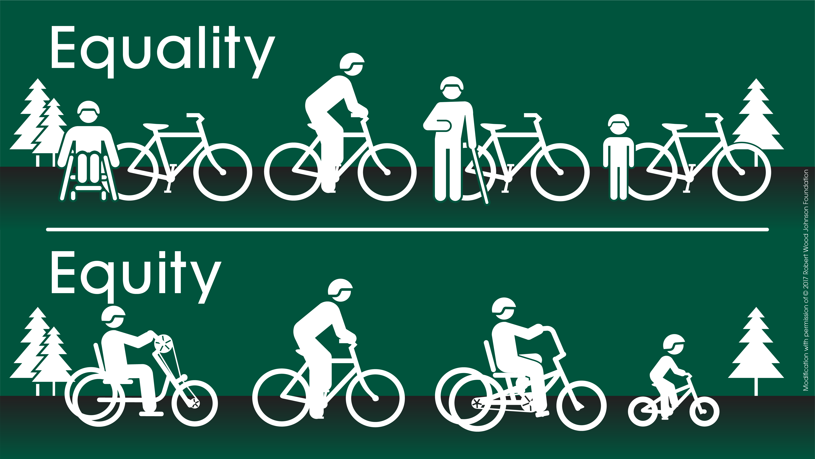
Equality Vs. Equity
Source: FHWA
Notes:
Key Message: Transportation equity means safe, accessible, affordable, reliable, comfortable, and healthy mobility that facilitates social and economic opportunities and meets the needs of all community members, particularly those identified as underserved, disadvantaged or overburdened.
Interactivity: Ask the audience for examples of the differences between equality and equity that they have witnessed. Ask if they are able to think of specific actions they take in their positions where equity can be integrated.
Background: Under equality, everyone gets the same resources. Under equity, the specific historical and present-day circumstances and abilities of individuals and communities are taken into consideration to provide appropriate solutions that provide everyone with opportunities to live safe and healthy lives.
Notes: Find more information at FHWA’s Planning Capacity Building site: https://www.planning.dot.gov/planning/topic_transportationequity.aspx

Slide 10
Coming Together for Equity
Notes:
Key Message: Equity encompasses and extends beyond EJ, Title VI, NEPA and the ADA.
Interactivity: Ask how many attendees have experience with Title VI, NEPA, EJ and ADA. Ask how safety professionals can collaborate with these program experts. Ask how Equity extends beyond these programs: it expands the populations of interest and encourages integration into other program areas, like safety.
Background: Environmental justice (EJ) identifies and addresses disproportionately high and adverse environmental and health impacts on minority and low-income people. Title VI is part of the Civil Rights Act of 1964 and prohibits discrimination on the basis of race, color and national origin. The Americans with Disabilities Act (ADA) prohibits discrimination against individuals with disabilities in all areas of public life. Notes: Additional information on Title VI and the ADA can be found here: https://www.fhwa.dot.gov/civilrights/

Slide 11
Wealth Creation
Disadvantaged Business Enterprises
Source: USDOT
Notes:
Key Message: US DOT will provide technical assistance to minority owned and small disadvantaged businesses, help increase their understanding of how to navigate the USDOT contracting process, gain awareness of upcoming contract opportunities, and enhance their core competencies and skills—enabling them to more effectively compete for USDOT contracting opportunities and build wealth.
Interactivity: No interactivity for this slide.
Background: No background for this slide.
Notes: Additional information on US DOT’s Disadvantaged Business Enterprises (BDE) program is available at https://www.transportation.gov/civil-rights/disadvantaged-business-enterprise.

Slide 12
Power of Community
Promising Practices for Meaningful Public Involvement in Transportation Decision-Making
Transportation Disadvantage Community
Source: USDOT
Notes:
Key Message: US DOT aims to ensure that individuals and communities have a greater voice in transportation decisions affecting them.
Interactivity: No interactivity for this slide.
Background: No background for this slide.
Notes: US DOT’s Guide on Promising Practices for Meaningful Public Involvement in Transportation Decision-Making is available at https://www.transportation.gov/priorities/equity/promising-practices-meaningful-public-involvement-transportation-decision-making. DOT’s GIS tool for identifying Transportation Disadvantage Community is available at https://www.arcgis.com/apps/dashboards/d6f90dfcc8b44525b04c7ce748a3674a.

Slide 13
Interventions
Thriving Communities Program
Justice40
Source: USDOT
Notes:
Key Message: US DOT aims to ensure that historically overburdened and underserved communities in urban and rural areas benefit from access to a generational investment in the nation’s infrastructure through direct, hands-on technical support for transportation projects with local impact.
Interactivity: No interactivity for this slide.
Background: No background for this slide.
Notes: Additional information on US DOT’s Thriving Community’s Program can be found at https://www.transportation.gov/grants/thriving-communities#:~:text=Funded%20with%20%2425%20million%20through,health%20policy%20outcomes%20have%20the. Additional information on US DOT’s implementation of the Justice40 initiative can be found at https://www.transportation.gov/equity-Justice40.

Slide 14
Expanding Access
Reconnecting Communities Pilot Program
Safe Streets and Roads for All
Source: USDOT
Notes:
Key Message: US DOT aims to increase social and economic opportunity for disadvantaged and underserved communities by supporting the provision of affordable multi-modal transportation options and developing a transportation cost burden measure.
Interactivity: No interactivity for this slide.
Background: No background for this slide.
Notes: Information on US DOT’s Reconnecting Community’s Pilot program can be found at https://www.transportation.gov/grants/reconnecting-communities. Information on US DOT’s Safe Streets and Roads for All program can be found at https://www.transportation.gov/grants/SS4A#:~:text=The%20SS4A%20program%20funds%20regional,injuries%20on%20our%20nation's%20roadways..

Slide 15
Presentation Overview
1
2
3
4
5
US DOT Equity Action Plan
Equity in the Safe System Approach
Equity in the Safe System Principles
Equity in the Safe System Elements
Conclusion & Resources

Slide 16
Top Takeaways
Reaching zero deaths requires eliminating disparities by prioritizing equity
Achieving an equitable Safe System requires all principles and elements to integrate equity
Notes:
Key Message:

Slide 17
Thousands of Lives are Lost Each Year
Total US Traffic Fatalities
2011-2020
Source: NHTSA
Notes:
Key Message: Traffic fatalities are a public health crisis affecting all road users, and it demands a concerted response. Each year, over a million lives are lost globally from traffic crashes. In 2019, an average of more than 100 people lost their lives on US roads, each day.
Interactivity: Ask attendees if they know what the fatality trends are in their communities.
Background: This slide shows the total police-reported US fatalities of motor vehicle traffic crashes, 2009-2019. This is the number of people who died, as opposed to the number of crashes, and it includes all motor vehicle occupants, motorcyclists, pedestrians, bicyclists, and people traveling by other modes. Data are from the NHTSA FARS database: https://www-fars.nhtsa.dot.gov/Main/index.aspx for up to 2018, and https://crashstats.nhtsa.dot.gov/Api/Public/ViewPublication/813060 for 2019 numbers.
Notes: Presenters can update data as they become available by using this query tool: https://cdan.dot.gov/query

Slide 18
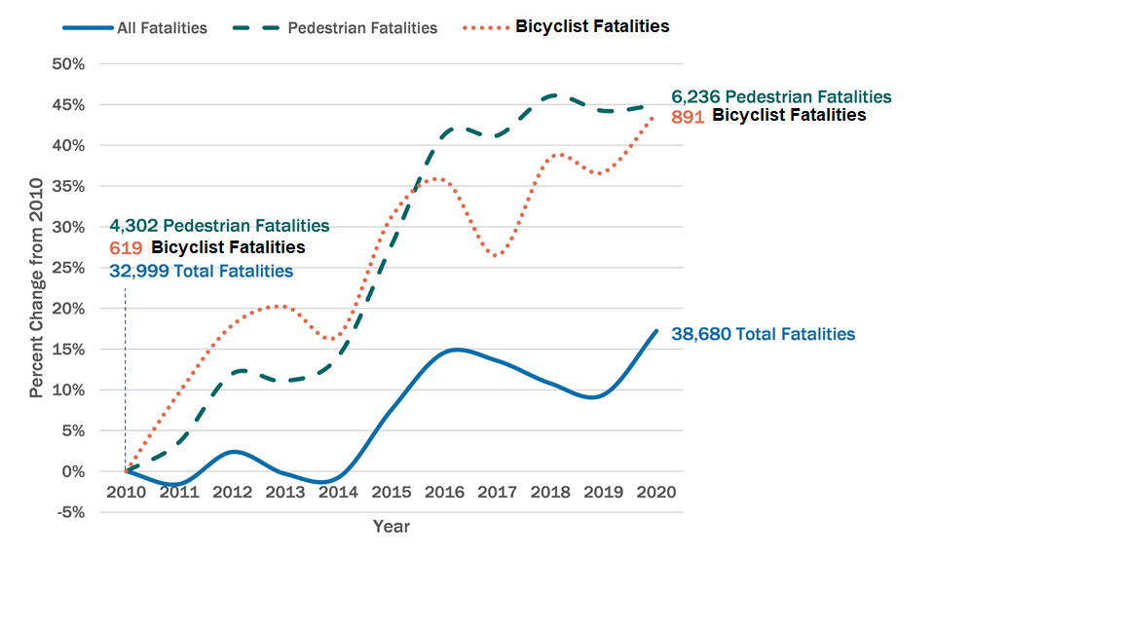
We have a National Roadway Safety Problem
Fatalities of pedestrians and bicyclists have been increasing even greater
Source: Fatality Analysis Reporting System
Notes:
Key Message: Fatalities of pedestrians and bicyclists have been increasing even greater.

Slide 19
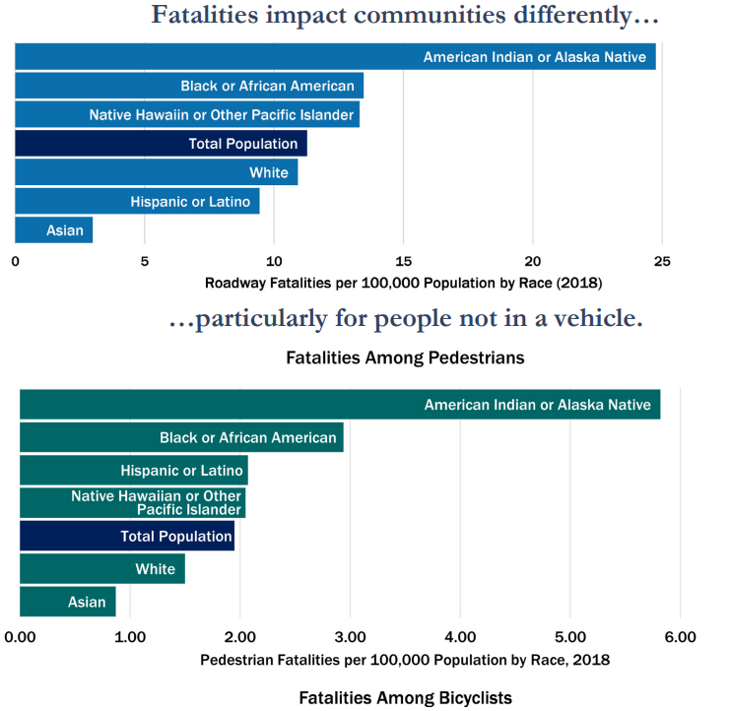
Disparities
“Traffic crashes are a leading cause of death for teenagers in America, and disproportionately impact people who are Black, American Indian, and live in rural communities. We face a crisis on our roadways; it is both unacceptable and solvable.”
Source: USDOT
Notes:
Key Message: Traffic fatalities and serious injuries disproportionately impact people who are Black and Indigenous, especially as pedestrians. People who are young, old, have low incomes, have disabilities, experience homelessness, and live in rural communities are also disproportionately impacted.
Interactivity: Ask the audience what communities in their area experience disparities.
Background: No background for this slide.
Notes: More information can be found at https://www.transportation.gov/sites/dot.gov/files/2022-02/USDOT-National-Roadway-Safety-Strategy.pdf

Slide 20
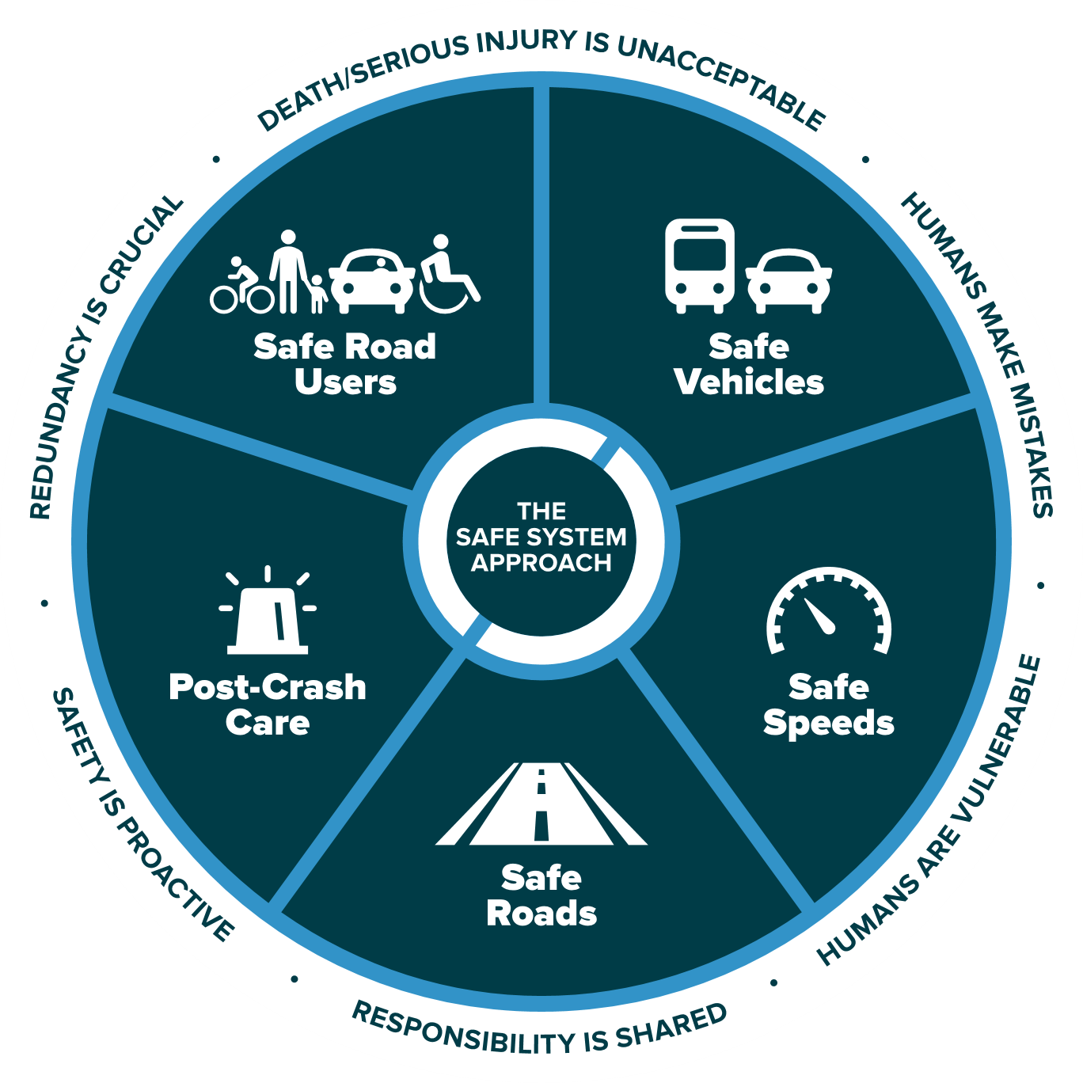
The Safe System Approach
Source: FHWA
Notes:
Key Message: This graphic presents an overview of the Safe System approach. There are three key components to understand, which will be explained on this and the following slides. These are the Safe System “approach,” “principles,” and “elements.” The Safe System “approach,” shown by the graphic on this slide, is the broadest term and describes all aspects of the Safe System.
In addition, the term “Safe System” is singular to depict an overall Safe Road System. The National Safety Council and our international partners also use this version.
Interactivity: No interactivity for this slide.
Background: This graphic was created for FHWA drawing inspiration from similar designs by the Institute of Transportation Engineers (ITE), the Road to Zero Coalition, and the Royal Society for the Prevention of Accidents (ROSPA) in the United Kingdom.
Notes: No notes for this slide.

Slide 21
Presentation Overview
1
2
3
4
5
US DOT Equity Action Plan
Equity in the Safe System Approach
Equity in the Safe System Principles
Equity in the Safe System Elements
Conclusion & Resources
Notes:
Key Message: This section provides information on how equity integrates into the six principles of the Safe System approach.
Interactivity: No interactivity for this slide.
Background: No background for this slide.
Notes: The six Safe System principles are: Death/Serious Injury is Unacceptable; Humans Make Mistakes; Humans Are Vulnerable; Responsibility is Shared; Safety is Proactive; and Redundancy is Crucial. They will be explained one-by-one on the following slides.

Slide 22
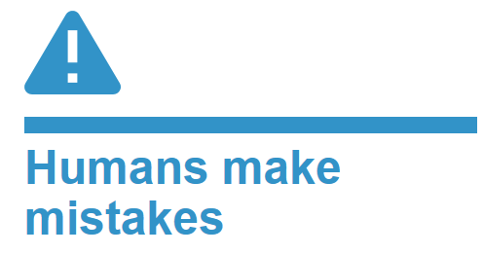
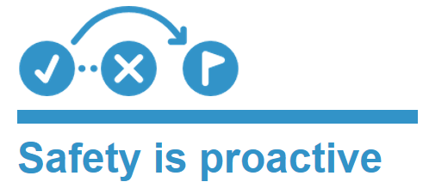
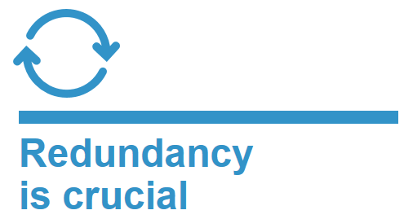
The 6 Safe System Principles
Source: FHWA
Notes:
Key Message: The six Safe System “principles,” shown around the outside ring of the graphic, are the fundamental beliefs that the approach is built on. They establish the goal of the Safe System approach, acknowledge human limitations, and set expectations for how to act. A successful Safe System approach weaves together all six principles. The principles will be discussed in depth in the next section.
Interactivity: No interactivity for this slide.
Background: No background for this slide.
Notes: No notes for this slide.

Slide 23
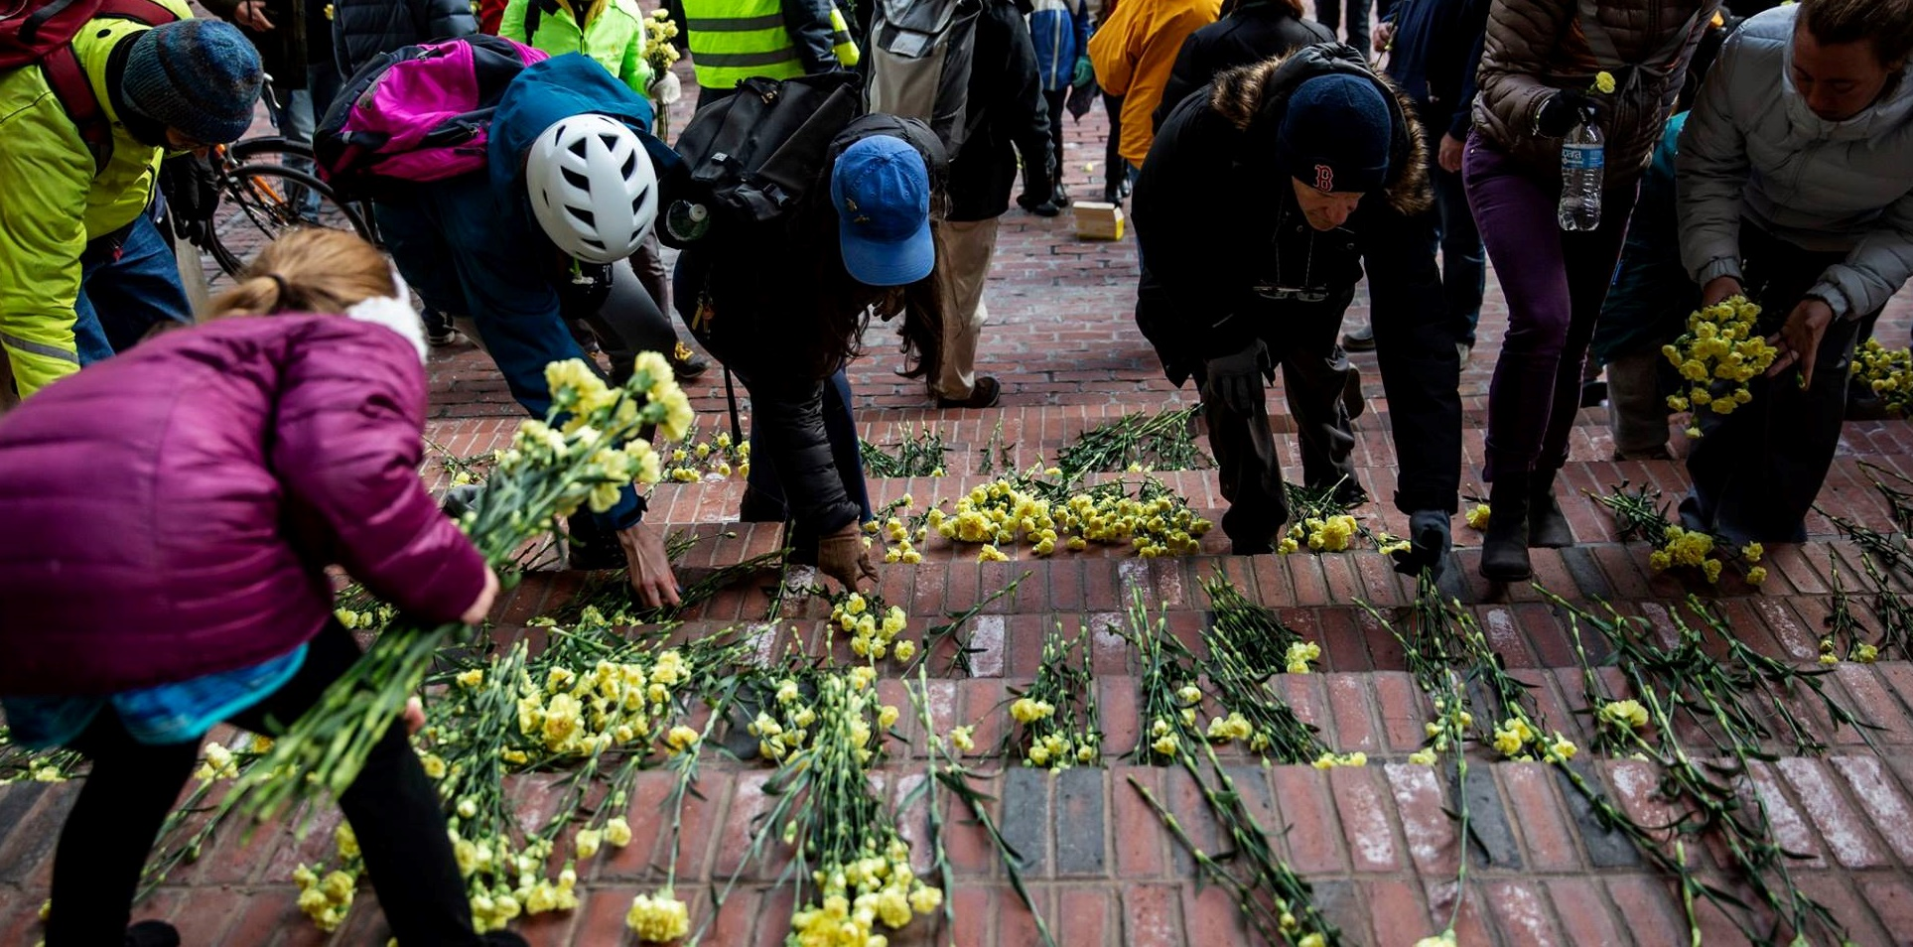
Death/serious injury is unacceptable
Source: Vision Zero Network
Notes:
Key Message: The first principle is that death and serious injury is unacceptable. While no crashes are desirable, the Safe System approach prioritizes crashes that result in death and serious injuries, since no one should experience either when using the roadway system. The goal is to modify how users, vehicles, transportation infrastructure, and emergency response operate to reduce the likelihood of crashes happening at all, and to reduce their severity when they do happen.
Interactivity: No interactivity for this slide.
Background: The image shows a memorial to people killed in traffic crashes.
Notes: This Toward Zero Deaths video is an option for speakers (note that it is 3:44 minutes long): https://youtu.be/_AIubBHtz7g

Slide 24
We will make more rapid progress toward the goal of zero deaths by addressing disparate traffic safety outcomes in underserved communities.
Source: FHWA
Notes:
Key Message: Death and serious injury is unacceptable for all communities. We will make more rapid progress toward the goal of zero deaths by addressing disparate traffic safety outcomes in underserved communities.
Interactivity: No interactivity for this slide.
Background: Health disparities are preventable differences in the burden of disease, injury, violence, or in opportunities to achieve optimal health experienced by socially disadvantaged racial, ethnic, and other population groups, and communities. No one should be killed on our roadways, and individuals should not be more exposed to disparate risks because of their races or ethnicities, languages, ages, abilities, and housing status. Yet, as established above, people living in underserved communities are disparately impacted by traffic fatalities and serious injuries, as well as multiple burdens of the transportation system including air pollution and a lack of access to essential destinations like grocery stores and medical care. The cause is multifaceted and dates back generations, and past federal transportation investments have too often failed to address inequities, or even made them worse. Because a piece of physical infrastructure endures for decades, families and communities today must contend with the results of discriminatory choices that may date back generations. For example, highways routed directly through Black and brown neighborhoods, often in an effort to divide and destroy them, continue to affect the wellbeing of the residents who remain. In other cases, we see inequities in our failures to invest, as with transit deserts that leave out the communities that most need affordable transportation options or contracting opportunities for transportation projects that fail to engage and utilize women and people of color. Today, we have the opportunity to prioritize these locations for investment and inclusive decision making to eliminate disparities and reach zero deaths.
Notes: More information can be found at https://www.cdc.gov/aging/disparities/index.htm#:~:text=Health%20disparities%20are%20preventable%20differences,other%20population%20groups%2C%20and%20communities.

Slide 25
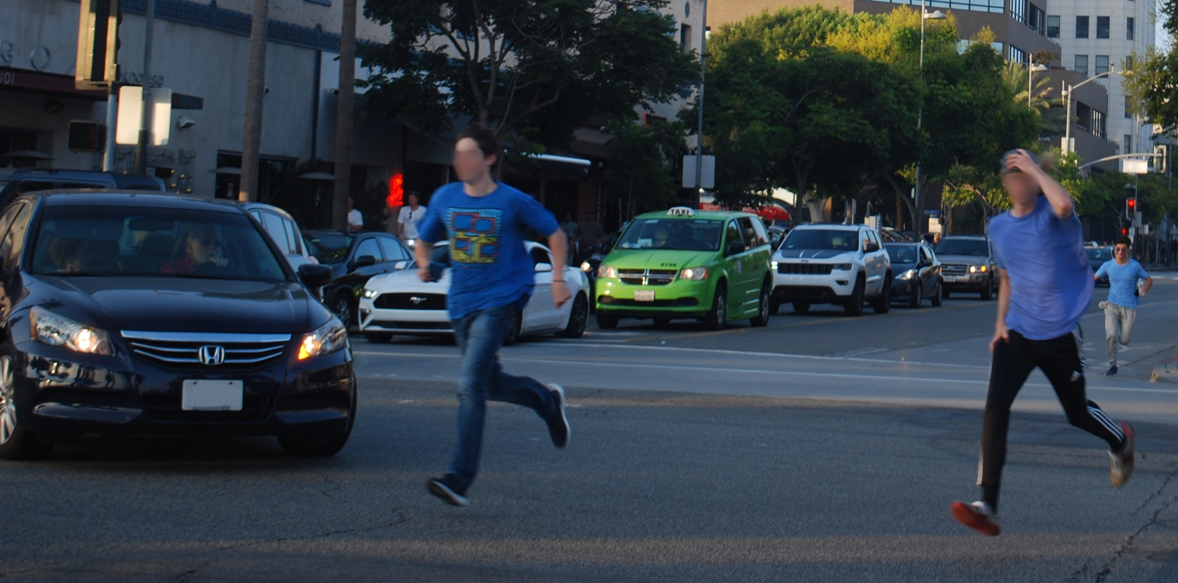
Humans make mistakes.
Source: Fehr & Peers
Notes:
Key Message: The next principle is that humans make mistakes. People will inevitably make mistakes that can lead to crashes, but we can design and operate the roadway system to accommodate human mistakes to avoid death and serious injuries.
Interactivity: No interactivity for this slide.
Background: The image shows two people making a mistake by violating traffic rules and risking a collision.
Notes: An example of designing a roadway to accommodate human mistakes is adding a median to prevent errant drivers from entering oncoming traffic.

Slide 26
A PUBLIC HEALTH FRAMEWORK FOR REDUCING HEALTH INEQUITIES
Source: Barhii
Notes:
Key Message: It is important not to victim blame. Traffic fatalities and serious injuries are often influenced by multiple factors: An individual's behavior is key – but these behaviors are also influenced by the individual’s built environment and design of the system. Instead, examine upstream factors that may impact people’s decisions.
Interactivity: Ask participants to determine where they currently are on this continuum. Are they able to influence upstream factors as a part of their job?
Background: Some environments make the “right” decision more difficult and “mistakes” the simpler option. For example, the lack of safe and convenient crossing opportunities may lead people to cross at unsafe points. Looking beyond human behavior to the systemic causes that may lead to a fatality and serious injury is critical. It is important not to victim blame.
Notes: The BARHII framework can be found here: https://www.barhii.org/barhii-framework.

Slide 27
HUMANS ARE VULNERABLE
Humans are vulnerable
Fatality
100%
Fatality Risk
Serious Injury
0%
Crash Kinetic Energy
27
Source: FHWA
Notes:
Key Message: The next principle is that humans are vulnerable. As the chart shows, people have a limited ability to tolerate crash impacts before death and serious injuries occur. Human tolerance to crash impacts is central to the Safe System approach. The management of kinetic energy transfer to within survivable limits is important for understanding how to design and operate the road system consistently with the Safe System philosophy. The Safe System approach focuses not just on managing speed but managing transfer of kinetic energy.
Interactivity: No interactivity for this slide.
Background: The graphic was created for FHWA to explain the concept that as crash kinetic energy increases, so too does the potential of serious injury and death. It does not take particularly high kinetic energy levels for the potential of serious injury to occur.
Notes: No notes for this slide.

Slide 28
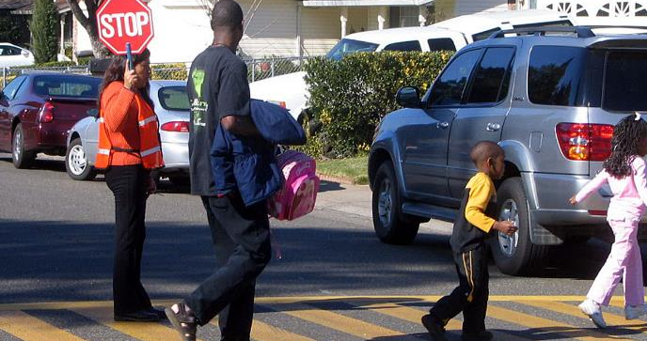
HUMANS ARE VULNERABLE PART 2
Source: PBIC, Dan Burden
Notes:
Key Message: In addition to biological vulnerability, social risk factors increase human vulnerability. Planning and engineering solutions can prevent or minimize these social vulnerabilities. For example, historic decision-making processes in transportation safety planning and funding may not have included meaningful public engagement. Identifying communities experiencing disparities, engaging with them to understand their specific concerns and priorities, and planning and implementing solutions with the community can redress historical inequities and minimize social vulnerabilities today.
Interactivity: No interactivity for this slide.
Background: No background for this slide.
Notes: No notes for this slide.

Slide 29
Responsibility is shared
System managers
Planners, designers, builders, operators, maintenance workers
Vehicle manufacturers
Enforcement personnel
Traffic Incident Management personnel
Everyone
Notes:
Key Message: The next principle is that responsibility is shared. System managers, vehicle manufacturers, law enforcement, post-crash personnel, and system users all have a responsibility to build and use a transportation system that prioritizes safety and creates livable communities.
Interactivity: No interactivity for this slide.
Background: No background for this slide.
Notes: Examples include system managers designing facilities with proven safety countermeasures, like roundabouts or median barriers; system managers keeping roadway systems in good state of repair; vehicle manufacturers applying the latest safety features in vehicles; law enforcement equitably enforcing traffic safety laws; and users of all travel modes safely moving through the roadway system. “System managers” includes planners, designers, builders, operators, and maintenance.

Slide 30
Engagement and collaboration are Critical
Engage in meaningful public involvement
Coordinate with community members and experts outside of transportation (public health, housing, education)
Train, hire, retain, and promote individuals from underserved communities
Notes:
Key Message: To ensure shared responsibility, the lived experiences of individuals living in communities and the knowledge of experts beyond the transportation discipline must be integrated into the planning, design and operations of a safe transportation system.
Interactivity: No interactivity for this slide.
Background: No background for this slide.
Notes: No notes for this slide.

Slide 31
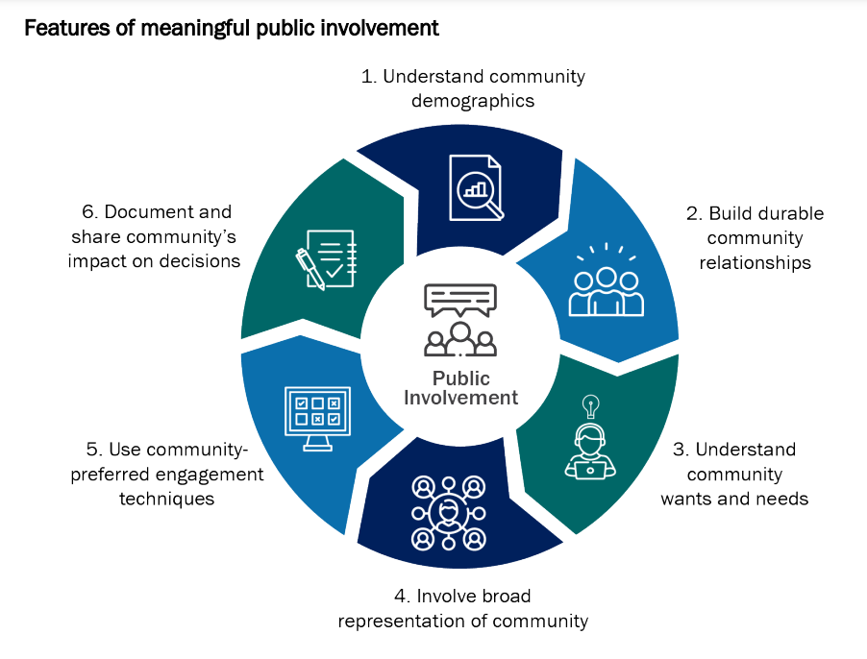
Meaningful Public Involvement is a part of shared responsibility
USDOT defines meaningful public involvement as a process that proactively seeks full representation from the community, considers public comments and feedback, and incorporates that feedback into a project, program, or plan when possible. The impact of community contributions encourages early and continuous public involvement and brings diverse viewpoints and values into the transportation decision-making process.
Source: USDOT
Notes:
Key Message: The impact of community contributions encourages early and continuous public involvement and brings diverse viewpoints and values into the transportation
Interactivity: No interactivity for this slide.
Background: No Background for this slide.
Notes: US DOT’s Guide on Promising Practices for Meaningful Public Involvement in Transportation Decision-Making is available at https://www.transportation.gov/priorities/equity/promising-practices-meaningful-public-involvement-transportation-decision-making.

Slide 32
Safety is proactive
Identify risks
Mitigate risks
Notes:
Key Message: The next principle is that safety is proactive. In addition to crash-based analysis, transportation agencies should use proactive tools to identify and mitigate latent risks in the roadway system, rather than waiting for crashes to occur and reacting afterwards. This process, known as the Systemic Approach to Safety, uses crash history, roadway design, and other data to identify patterns in geometric design that lead to certain crash types. System designers then identify appropriate countermeasures to mitigate the crash types. These countermeasures are systemically applied at all locations meeting the particular geometric design, irrespective of crash history. Rather than managing risk at certain locations, a systemic approach takes a broader view and evaluates risk across an entire roadway system. A system-based approach acknowledges crashes alone are not always sufficient to determine what countermeasures to implement, particularly on low-volume local and rural roadways where crash densities are lower, and in many urban areas where there are conflicts between vehicles and vulnerable road users (pedestrians, bicyclists, and motorcyclists).
Interactivity: The speaker may want to facilitate a discussion among the audience: "I have limited funds. How can I justify addressing latent risks when I have other locations with a history of crashes? I don't have funding to do both.“
Background: No background for this slide.
Notes: Additional information on the Systemic Approach to Safety is available at https://safety.fhwa.dot.gov/systemic/

Slide 33
Equity is proactive
Identify risks based on equity screening
Mitigate risks for underserved communities
Notes:
Key Message: Equity metrics, including demographic, social, and public health data, can provide predictive and systemic methods of identifying and prioritizing locations with high fatal and serious injury crash risks. Implementing countermeasures proactively by prioritizing underserved communities will help to redress disparities experienced by these communities.
Interactivity: The speaker may want to facilitate a discussion among the audience: “What equity factors can predict crash fatality and serious injury?”
Background: No background for this slide.
Notes: Noteworthy examples on how equity can be integrated into data-driven safety analysis can be found here: https://rspcb.safety.fhwa.dot.gov/noteworthy/default.aspx.

Slide 34
Redundancy is crucial
Safe road users
Safe vehicles
Safe speeds
Safe roads
Post-crash care
Notes:
Key Message: The final principle is that redundancy is critical. Reducing risks requires that all parts of the roadway system are strengthened, so that if one part fails, people are still protected. This is the last of the six Safe System principles. The next section will address the five Safe System elements.
Interactivity: Ask the audience if they have questions about the principles.
Background: No background for this slide.
Notes: An example of redundancy is rumble strips, which protect people when their own ability to be safe road users is compromised by distraction or drowsiness.

Slide 35
the 5 Safe System Elements Create Redundancy
The “Swiss Cheese Model” of redundancy creates layers of protection
Death and serious injuries only happen when all layers fail
Safe road users
Safe road users
Safe vehicles
Safe vehicles
Safe speeds
Safe speeds
Safe roads
Safe roads
Post-crash care
Post-crash care
Source: FHWA
Notes:
Key Message:
The left graphic shows how five Safe System elements work together, such that if one part fails, there are redundant systems in place. The “Swiss Cheese Model” helps demonstrate this redundancy. Layered safety measures are represented as slices of swiss cheese with the holes being weaknesses in individual parts of the system. The holes represent weakness causing failures or latent condition. When the cheese slices act as successive layers of defenses and the holes are not lined up, a person is protected.
The right graphic shows that a failure only results when a hole in each slice momentarily aligns, permitting a hazard to pass through holes in all the slices. The basic principle is that lapses and weaknesses in one part of the system can occur, but other parts compensate to not allow a failure. This relates back to the Safe System principles that redundancy is critical and responsibility is shared.
We’ve now discussed all six Safe System principles and all five Safe System elements. The next section of the presentation focuses on Safe System case studies.
Interactivity: Optional break for questions.
Background:
The “Swiss Cheese Model” is applicable to numerous risk management fields and was originally espoused by Dante Orlandella and James T. Reason of the University of Manchester. The graphic was adapted for FHWA from their work to explain the redundancy of the five Safe System elements.
We showed the previous slide where all the holes are lined up, meaning redundancy isn’t there. This slide shows cheese slices with the holes not lined up and how redundancy works.
Notes: A good example of how the five Safe System elements work together to create redundancy is distracted driving. Education campaigns focused on alert driving—avoiding behaviors like texting while driving—help create safe road users. Vehicle safety systems, like lane departure warnings, create safe vehicles that alert distracted drivers to potential hazards. Enforcement can help maintain safe speeds, so that if an incident should occur due to distracted driving, impact forces on the human body remain within tolerable levels. Infrastructure like rumble strips creates safe roads and an additional layer of redundancy to warn distracted drivers about a potential roadway departure. Sometimes, all these measures are not enough to prevent a distracted driving crash from occurring, but efficient, rapid post-crash care can help this mistake not be fatal.

Slide 36
Presentation Overview
1
2
3
4
5
US DOT Equity Action Plan
Equity in the Safe System Approach
Equity in the Safe System Principles
Equity in the Safe System Elements
Conclusion & Resources

Slide 37
The 5 Safe System Elements
Source: FHWA
Notes:
Key Message: The five Safe System “elements,” highlighted in the middle ring of the graphic, are conduits through which the Safe System approach must be implemented. The key focus of the Safe System approach is to reduce death and serious injuries through design that accommodates human mistakes and injury tolerances. Making a commitment to zero deaths means addressing every aspect of crash risks through the five elements of a Safe System. These layers of protection and shared responsibility promote a holistic approach to safety across the entire roadway system. The five elements will be discussed in depth later in the presentation.
Interactivity: No interactivity for this slide.
Background: No background for this slide.
Notes: No notes for this slide.

Slide 38
Safe ROADS for Users of all ages and abilities
Safe roads
Safe roads are designed and operated to:
Prevent crashes among all users
Keep impacts on the human body at tolerable levels
Serve road users of all ages and abilities, including pedestrians, bicyclists, public transportation users, children, older individuals, individuals with disabilities, motorists, and freight operators.
Notes:
Key Message: The first element we will address is safe roads. Safe roads are designed and operated to prevent crashes and keep impacts on the human body at tolerable levels. Critically, safe roads must create complete networks to serve people of all ages and abilities using whatever modes of transportation they choose or rely on.
Interactivity: No interactivity for this slide.
Background: No background for this slide.
Notes: This slide introduces the objective of Safe Roads. The specifics are detailed on the following slides.

Slide 39
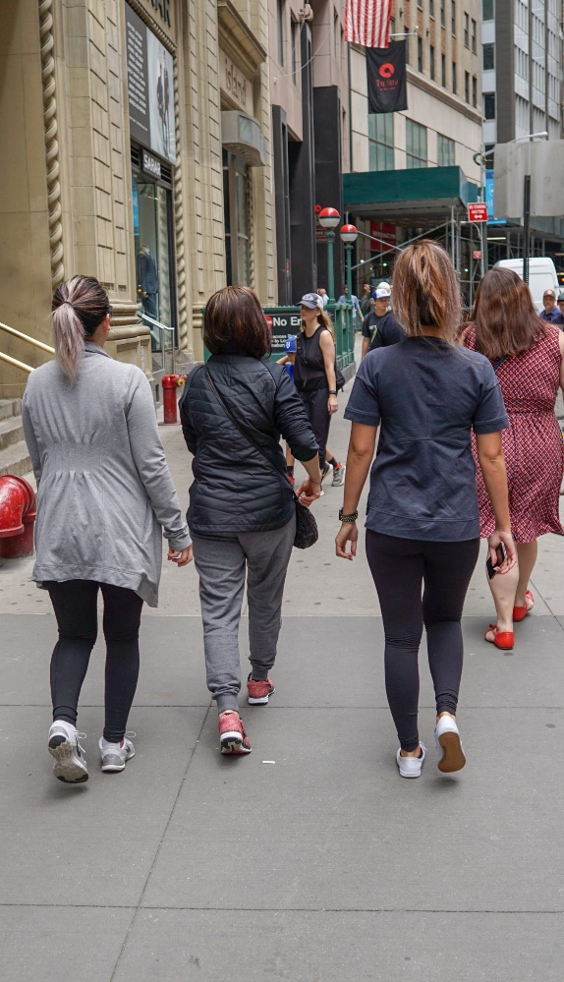
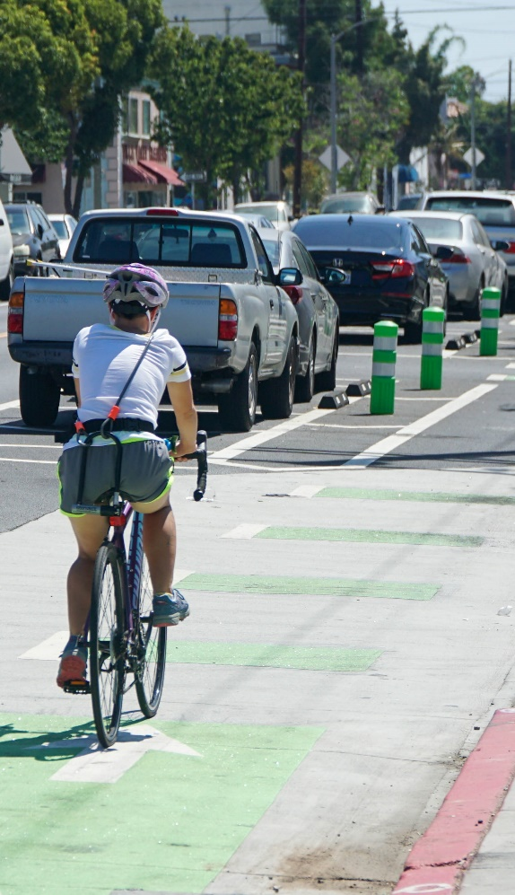
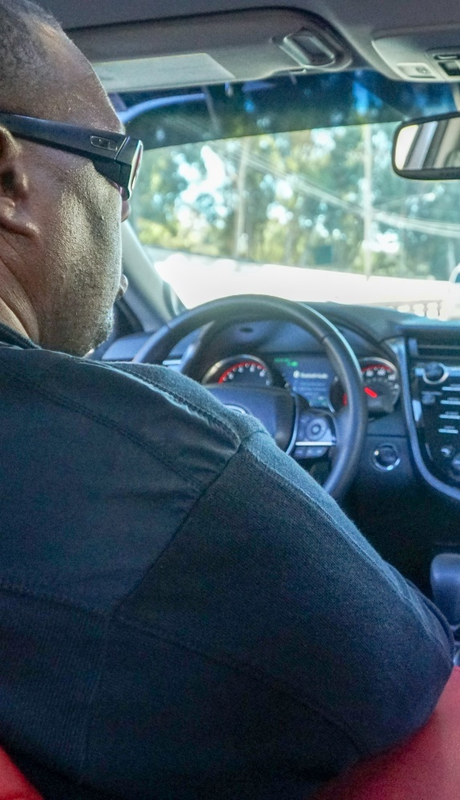
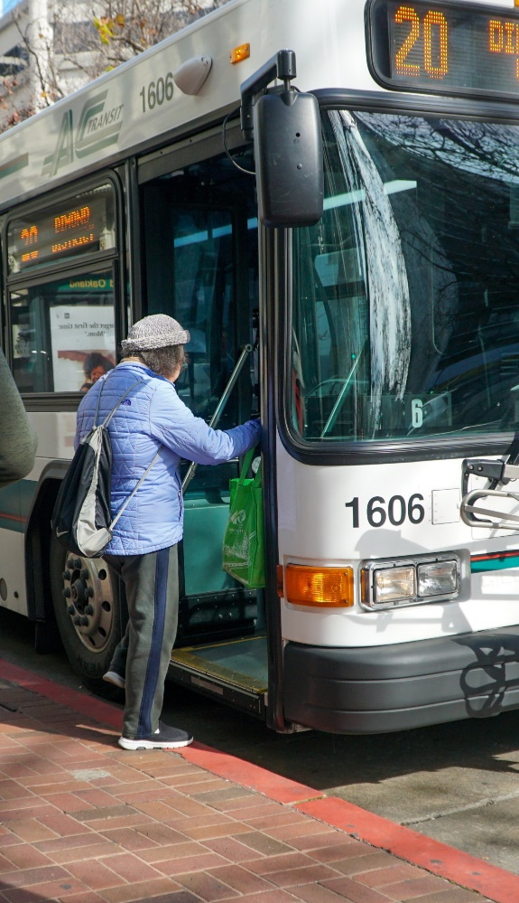
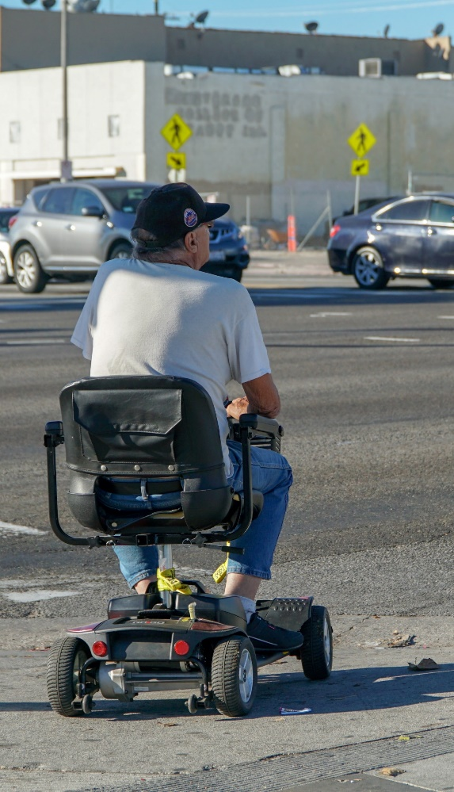
People first
Pedestrians
Bicyclists
Drivers and Passengers
Transit Users
People using assistive mobility technologies
People experiencing homelessness
Source for first five images: Fehr & Peer
Source for final image: Adobe Stock
Notes:
Key Message: The Safe System approach must address the safety of all road users, including those who walk, bike, drive, ride transit, use assistive mobility technologies, or travel by other modes. People experiencing homelessness should also be a considered. All road users are considered equal regardless of how they choose to travel.
Interactivity: Ask the audience: Are there any other people who use our roads whose safety we should consider in our design? How does prioritizing people, as opposed to vehicles, change the way we plan and design our roads and streets?
Background: The images show examples of the text below them.
Notes: No notes for this slide.

Slide 40
Universal Design
Safe roads
The design and composition of an environment so that it can be accessed, understood and used to the greatest extent possible by all people regardless of their age, size, ability or disability.
The seven principles of universal design are as follows:
Equitable Use
01
Flexibility in Use
02
Simple and Intuitive Use
03
Perceptible Information
04
Tolerance for Error
05
Low Physical Effort
06
Size and Space for Approach and Use
07
Source: Centers for Disease Control and Prevention
Notes:
Key Message: Universal design is an approach to design an environment so that it is accessible, understandable, and usable to the greatest extent possible by people of all ages, sizes, abilities or disabilities. The seven principles of Universal Design are: Equitable Use, Flexibility in Use, Simple and Intuitive Use, Perceptible Information, Tolerance for Error, Low Physical Effort, and Size and Space for Approach and Use.
Interactivity: Ask audience if they are familiar with universal design. Ask audience if they have examples of how they have incorporated universal design into their work.
Background: No background for this slide.
Notes: No notes for this slide.

Slide 41
Equitable Funding Process
Safe roads
Prioritize equity factors in funding formulas and project prioritization
1
Assess how certain criteria may unintentionally exclude underserved communities and widen disparities
2
Provide additional resources, including capacity building and safety study funding, to underserved communities
3
Engage in meaningful public involvement
4
Notes:
Key Message: Achieving safe roads requires investing equitable in underserved communities. First, prioritize equity factors in funding formulas and project prioritization. For example, a locality may use predictive equity metrics, like DOT’s disadvantage communities GIS tool, to distribute funding. Second, assess how certain criteria may unintentionally exclude underserved communities and widen disparities. For example, a State may remove local matching requirements from their funding distribution formulas to avoid unintentionally shutting out localities with low capacities. Third, provide additional resources, including capacity building and safety study funding, to underserved communities. For example, a higher capacity locality may partner with a lower capacity locality to bundle safety projects and implement countermeasures systematically. Fourth, engage in meaningful public involvement. For example, establish a community advisory board with members of underserved community to ensure that communities are represented in decision making processes.
Interactivity: Ask participants if they have examples of how these actions can transform the project prioritization and funding processes.
Background: No background for this slide.
Notes: No notes for this slide.

Slide 42
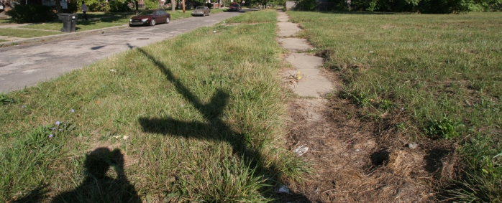
Asset Management
Safe roads
Source: PBIC, Dan Burden
Notes:
Key Message: Finally, achieving safe roads means equitably managing or replacing facilities to ensure longevity. Upgrading facilities based on complaints may unintentionally leave underserved communities out. Systemic approaches for upgrading facilities may improve safety in a more equitable manner for all communities. For example, review funding models and policies for sidewalk and lighting upgrades and repairs.
Interactivity: Ask participants if they have examples of how current policies for sidewalk and lighting upgrades and repairs may promote inequities.
Background: No background for this slide.
Notes: No notes for this slide.

Slide 43
Where are You on the Equitable Safe System Journey?
Traditional Approach | Safe System Approach | Equitable Safe System Approach
Prevent crashes | Prevent death and serious Injuries | Prioritize redressing disparities in death and serious injuries
Improve human behavior | Design for human mistakes/limitations | Address upstream factors and do not victim blame
Control speeding | Reduce systemic kinetic energy | Create livable communities
Individuals are responsible | Share responsibility | Institutions can take on more responsibility because they have greater influence
React based on crash history | Proactively identify and address risks | Use equity indicators and meaningful public involvement to proactively identify and redress risk

Slide 44
Presentation Overview
1
2
3
4
5
US DOT Equity Action Plan
Equity in the Safe System Approach
Equity in the Safe System Principles
Equity in the Safe System Elements
Conclusion & Resources

Slide 45
US DOT Resources
Equity
Find more resources at: https://www.transportation.gov/priorities/equity
Notes:
Key Message: US DOT has published multiple resources on its equity programs. Check back frequently for updates.
Interactivity: No interactivity for this slide.
Background: No background for this slide.
Notes: No notes for this slide.

Slide 46
FHWA Resources
Safe System Materials
Find more resources at: safety.fhwa.dot.gov/zerodeaths
Notes:
Key Message: FHWA is developing resources to help agencies implement the Safe System approach equitably. This includes a series of noteworthy practices that will be published soon.
Interactivity: No interactivity for this slide.
Background: No background for this slide.
Notes: No notes for this slide.

Slide 47
Zero is our goal.
A Safe System is how we get there.
Questions?

