Slide 1

Focus Crash and Facility Type (FCFT): Researcher Workshop
An Evaluation of Low-Cost Safety Improvements Pooled Fund Study Effort
Eric Donnell
Vikash Gayah
Pennsylvania State University
Frank Gross
Thanh Le
VHB
November 15, 2021
November 3, 2021
VHB
© Uschools/iStock.

Slide 2
Disclaimer
This presentation was created and is being presented by contractors. The views and opinions expressed in this presentation are the presenters’ and do not necessarily reflect those of the Federal Highway Administration (FHWA) or the U.S. Department of Transportation (USDOT). The contents do not necessarily reflect the official policy of the USDOT.
The U.S. Government does not endorse products or manufacturers. Trademarks or manufacturers’ names appear in this presentation only because they are considered essential to the objective of the presentation. They are included for informational purposes only and are not intended to reflect a preference, approval, or endorsement of any one product or entity.

Slide 3
Purpose of the Workshop and Learning Objectives

Slide 4
Workshop Purpose
Provide an overview of data, methods, and results of FHWA Report, Contributing Factors for Focus Crash and Facility Types (FHWA-HRT-20-052).⁽¹⁾
Identify opportunities for future research to build on FHWA FCFT methods and findings.

Slide 5
Today’s Learning Objectives
Discover the systemic approach and its application to highway safety.
Recognize the role of data and data analysis methods in the systemic approach.
Identify resources that can support the systemic approach.
Learn about risk factors and how they are identified and inform the systemic approach.
Recognize shortcomings/challenges and identify potential needs for future research.

Slide 6



Workshop Icons
Information from Contributing Factors for Focus Crash and Facility Types report or The Development of Crash Modification Factors: Highway Safety Statistical Paper Synthesis report.^{(1,2)}
Applications and extensions of methods presented in the FHWA FCFT report.⁽¹⁾
Source: FHWA.

Slide 7

Questions?
?
Source: FHWA.
Please ask in the chat panel.

Slide 8
Workshop Outline
Present an overview of the systemic approach of FCFT.
Identify FCFTs:
  Review FHWA FCFT study.
  Develop agency-specific FCFTs.
Identify and evaluate risk factors:
  Provide examples from FHWA FCFT study.
  Identify agency-specific risk factors.
Provide an overview of screening and prioritizing candidate locations.
Present an overview of six-step countermeasure selection.
Provide an overview of systemic program evaluation methods.
Hold discussions and identify opportunities for future research.

Slide 9
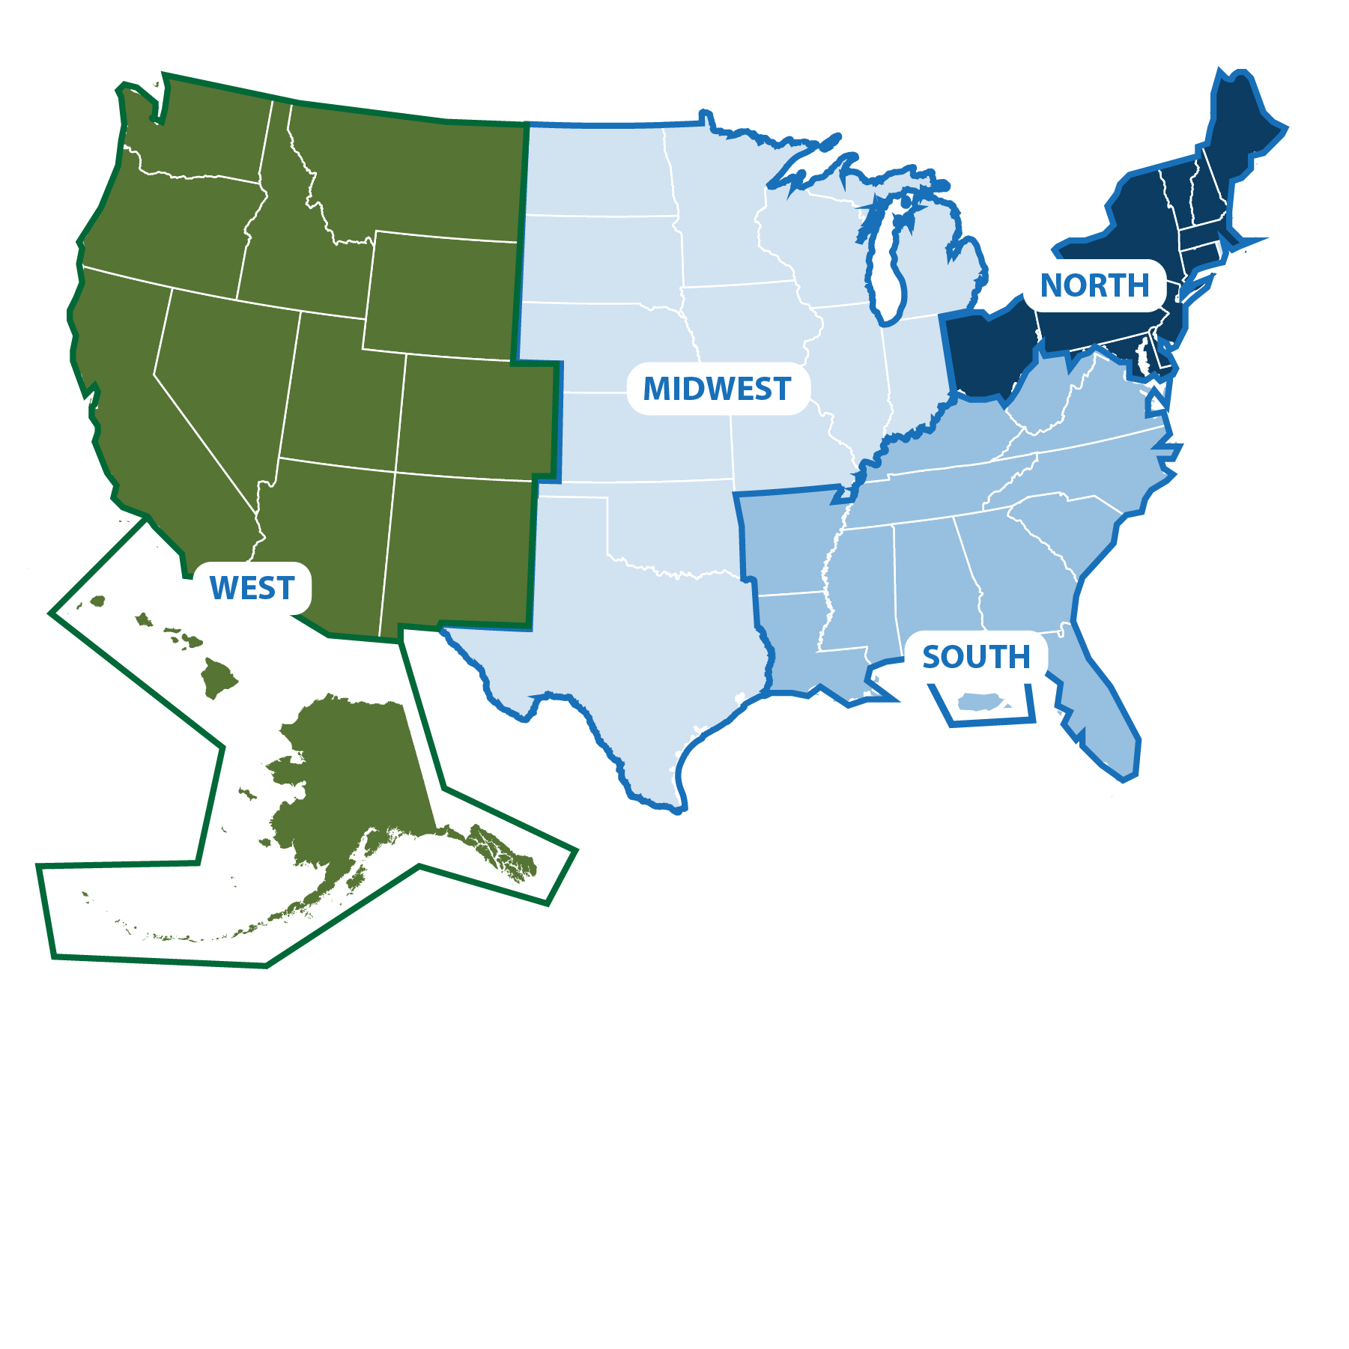



Polling Question
Q1
Source: FHWA.
Source: FHWA.
From what region are you calling?
Notes:
Brief intro/engagement slide – what State are you calling in from today?
Poll: What region are you calling in from:
North
Midwest
South
West
Something else

Slide 10
Polling Question
Q2
Source: FHWA.
Are you familiar with the systemic approach?
Notes:
Are you familiar with the systemic method? Answers: Yes/No/Not sure

Slide 11
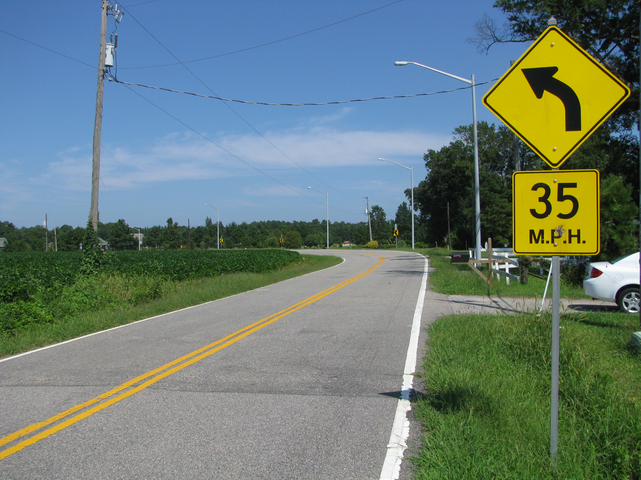
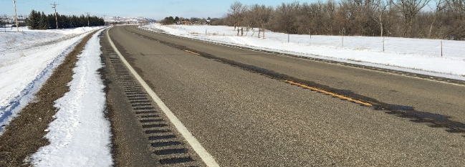
Systemic Definition
“Systemic safety improvement” means a proven safety countermeasure(s) that is widely implemented based on high-risk roadway features that are correlated with particularly severe crash types.⁽³⁾
Systemic method identifies and proactively treats sites with certain features that are more conducive to safety problems, including sites without any problems observed yet.
All photo source: FHWA.

Slide 12
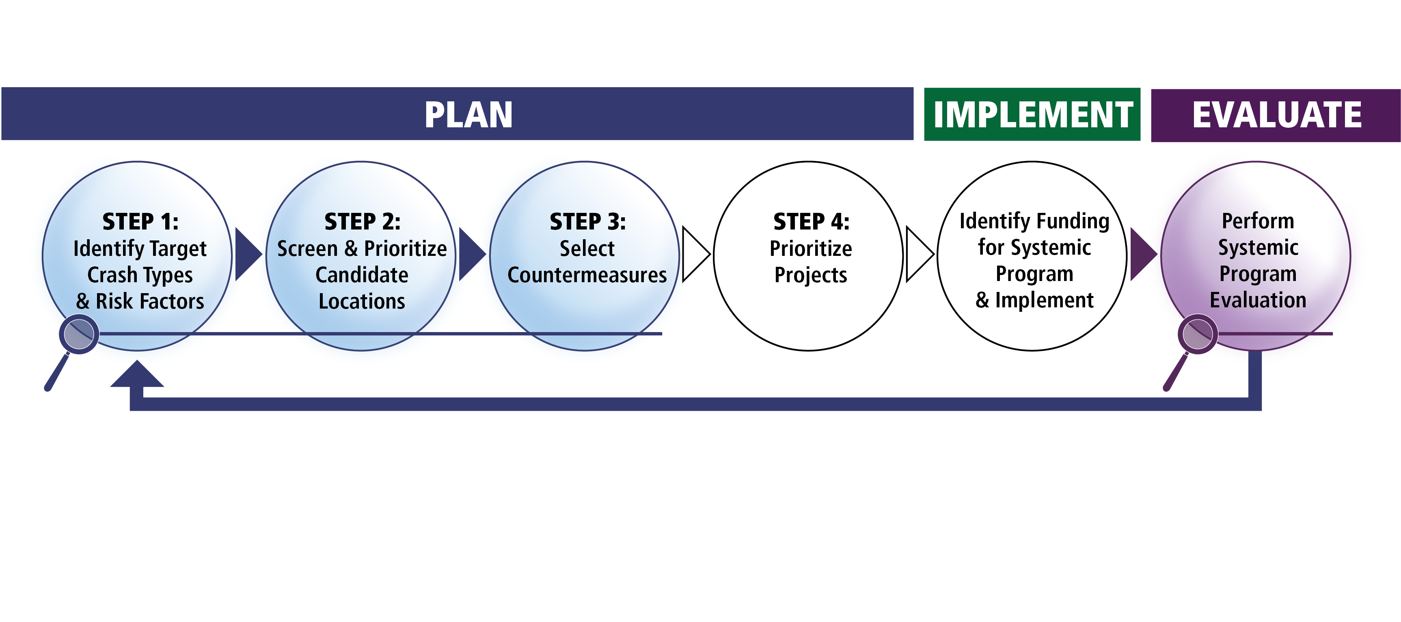
Overview of the Systemic Approach
Source: FHWA. Modified by FHWA.⁽⁴⁾

Slide 13
Polling Question
Q3
Source: FHWA.
Are you familiar with the terms focus crash type and facility type?
Notes:
Are you familiar with the term focus crash type? Yes/No/I’ve heard it before but not sure what it means

Slide 14
Systemic Approach:
Select Focus Crash Types
What does “focus crash type” mean?
  It is a crash type that represents the greatest number of severe crashes across the roadway system of interest.
  It provides the greatest potential to reduce fatalities and severe injuries:
    Roadway departure (RwD).
    Intersection.
    Pedestrian.
    Speed.
U.S. Fatalities by FHWA Focus Area
(FARS 2014–2016)
Source: National Highway Traffic Safety Administration (NHTSA) data. Created by FHWA.⁽⁵⁾
Ped = pedestrian; FARS = Fatality Analysis Reporting System.

Slide 15
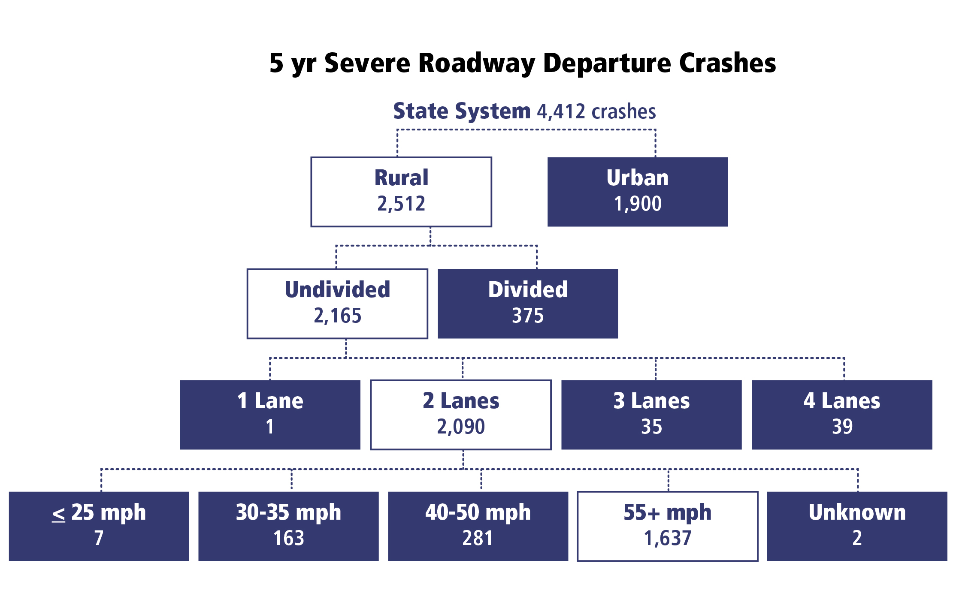
Systemic Approach: Select Focus Facilities
What does “focus facility” mean?
  A facility type where the focus crash type most frequently occurs:
    Rural, two-lane highways.
    Urban, signalized intersections.
    Horizontal curves.
    Rural, thru-stop intersections.
Source: FHWA. Modified by FHWA.⁽⁴⁾

Slide 16
FHWA FCFT Study Objectives
Select reliable and applicable data resources, statistical methodologies, analysis procedures, and tools.
Conduct data analysis to identify and validate FCFTs and their associated contributing factors.
Identify potential low-cost safety strategies that may effectively be used as systemic safety improvements.
Develop a technical report and a quick reference guide for identifying focus crash types and contributing factors.
Develop a solicitation and evaluation criteria to identify volunteer agencies to implement systemic safety improvements.

Slide 17

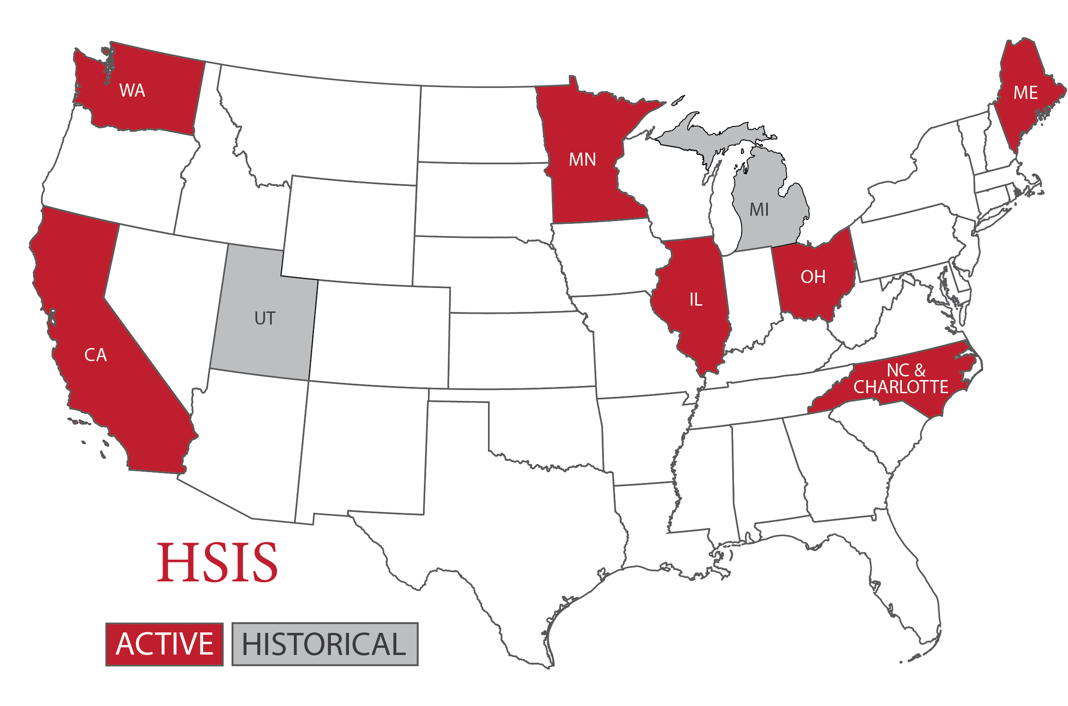
FHWA FCFT Report: Identifying FCFTs
Data sources:
FARS: 2010–2014:⁽⁵⁾
  Accident data file.
  Vehicle data file.
  Person data file.
Highway Safety Information System (HSIS):⁽⁶⁾
2009–2014 data from Washington, Ohio, California, and Minnesota:
  Accident data file.
  Roadway data file.
  Intersection data file (only needed for California).
  Curve data file (only needed for Washington).
Source: NHTSA.
Source: HSIS.⁽⁶⁾

Slide 18








FHWA FCFT Report: Identifying FCFTs
Define potential FCFTs by the various combinations of:
Crash type.
Area type
(rural or urban).
Roadway type.
Location (intersection or non-intersection).
Intersection type (four-leg or T- or Y-intersection).
Type of traffic control
(stop-controlled or signalized).
Lighting (day versus night).
Road alignment (horizontal curve versus straight/tangent).
All art source: FHWA.

Slide 19

FHWA FCFT Report: Identifying FCFTs
Rank potential FCFTs by:
  Number of fatal crashes (K).
  Fatal plus serious injury crashes (KA)
  for the HSIS States.
  Develop separate ranked lists to assess ranking consistency based on:
  FARS data.
  Data for each of the HSIS States.
Compare with the results of the process from FHWA’s Systemic
Safety Project Selection Tool.⁽⁴⁾
Source: FHWA.

Slide 20

FHWA FCFT Report: Identifying FCFTs
Example Crash Count Ranking: Potential Non-Intersection FCFTs From FARS⁽¹⁾
No. | Crash Type | Area Type | Roadway Type | Light Conditions | Road Alignment | K Crashes
1 | Fixed object | Rural | 2-lane road | Nighttime | Curve | 5,197
2 | Fixed object | Rural | 2-lane road | Daylight | Curve | 4,095
3 | Fixed object | Rural | 2-lane road | Nighttime | Straight | 4,094
4 | Fixed object | Rural | 2-lane road | Daylight | Straight | 3,825
5 | Head-on | Rural | 2-lane road | Daylight | Straight | 2,789
6 | Pedestrian | Urban | Multilane divided | Nighttime | Straight | 2,174
7 | Pedestrian | Urban | Multilane undivided | Nighttime | Straight | 2,118
8 | Pedestrian | Urban | 2-lane road | Nighttime | Straight | 2,051
9 | Pedestrian | Rural | 2-lane road | Nighttime | Straight | 1,918
10 | Angle | Rural | 2-lane road | Daylight | Straight | 1,815

Slide 21
FHWA FCFT Report: Identifying FCFTs
Example Crash Count Ranking: Potential Intersection FCFTs From FARS⁽¹⁾
No. | Crash Type | Area Type | Roadway Type | Int. Type | Traffic Control | Light Conditions | K Crashes
1 | Angle | Rural | 2-lane road | 4-leg | Stop Cntrl | Daylight | 2,424
2 | Angle | Urban | 2-lane road | 4-leg | Stop Cntrl | Daylight | 1,126
3 | Angle | Urban | Multilane divided | 4-leg | Signalized | Daylight | 977
4 | Angle | Urban | Multilane undivided | 4-leg | Signalized | Daylight | 864
5 | Angle | Rural | 2-lane road | 4-leg | Stop Cntrl | Nighttime | 750
6 | Angle | Urban | Multilane divided | 4-leg | Signalized | Nighttime | 684
7 | Angle | Rural | 2-lane road | T-Int | Stop Cntrl | Daylight | 592
8 | Pedestrian | Urban | Multilane divided | 4-leg | Signalized | Nighttime | 589
9 | Angle | Urban | Multilane undivided | 4-leg | Signalized | Nighttime | 555
10 | Angle | Urban | 2-lane road | T-Int | Stop Cntrl | Daylight | 536
T-Int = T-intersection; Cntrl = control.

Slide 22
FHWA FCFT Report: Identifying FCFTs
Example Crash Count Ranking: Potential Non-Intersection FCFTs From HSIS Ohio Data (by KA Crashes)⁽¹⁾
No. | Crash Type | Area Type | Roadway Type | Light Conditions | Road Alignment | KA Crashes
1 | Fixed object | Rural | 2-lane roads | Daylight | Straight | 1,027
2 | Fixed object | Rural | 2-lane roads | Nighttime | Straight | 792
3 | Fixed object | Rural | 2-lane roads | Daylight | Curve | 773
4 | Fixed object | Urban | Freeways | Daylight | Straight | 590
5 | Fixed object | Rural | 2-lane roads | Nighttime | Curve | 569
6 | Rear end | Urban | Freeways | Daylight | Straight | 565
7 | Fixed object | Urban | Freeways | Nighttime | Straight | 522
8 | Rear end | Rural | 2-lane roads | Daylight | Straight | 409
9 | Sideswipe—meeting | Rural | 2-lane roads | Daylight | Straight | 391
10 | Sideswipe—passing | Urban | Freeways | Daylight | Straight | 348

Slide 23
FHWA FCFT Report: Identifying FCFTs
Example Crash Count Ranking: Potential Intersection FCFTs From HSIS Ohio Data (by KA Crashes)⁽¹⁾
No. | Crash Type | Area Type | Roadway Type | Location Type | Light Conditions | K Crashes | KA Crashes
1 | Angle | Rural | 2-lane roads | Intersection | Daylight | 153 | 1,152
2 | Angle | Urban | Multilane undivided | Intersection | Daylight | 29 | 657
3 | Angle | Urban | Multilane divided | Intersection | Daylight | 33 | 511
4 | Rear end | Urban | Multilane undivided | Intersection | Daylight | 10 | 338
5 | Angle | Rural | 2-lane roads | Intersection | Nighttime | 48 | 296
6 | Angle | Urban | Multilane divided | Intersection | Daylight | 27 | 243
7 | Rear end | Urban | 2-lane roads | Intersection | Daylight | 5 | 243
8 | Angle | Urban | Multilane undivided | Intersection | Nighttime | 10 | 242
9 | Angle | Rural | 2-lane roads | Intersection | Daylight | 25 | 213
10 | Rear end | Rural | 2-lane roads | Intersection | Daylight | 13 | 205

Slide 24
FHWA FCFT Report: Identifying FCFTs
List of Non-Intersection FCFTs
Run-off-road (ROR) crashes on rural two-lane roads on horizontal curves (daytime and nighttime).
ROR crashes on rural two-lane roads on straight segments (daytime and nighttime).
Lane-departure crashes on rural two-lane roads on horizontal curves (daytime and nighttime).
Lane-departure crashes on rural two-lane roads on straight segments (daytime and nighttime).
Head-on crashes on rural two-lane roads on horizontal curves (daytime and nighttime).
Head-on crashes on rural two-lane roads on straight segments (daytime and nighttime).
Rollover crashes on rural two-lane roads on straight segments (daytime and nighttime).
Rollover crashes on rural two-lane roads on horizontal curves (daytime and nighttime).
Angle crashes on rural two-lane roads on straight segments (daytime).

Slide 25
FHWA FCFT Report: Identifying FCFTs
List of Intersection FCFTs
  Angle crashes on rural two-lane roads at four-leg stop-controlled intersections (daytime and nighttime).
  Angle crashes on urban two-lane roads at four-leg stop-controlled intersections (daytime).
  Angle crashes on urban multilane divided roads at four-leg signalized intersections (daytime).
  Angle crashes on urban multilane undivided roads at four-leg signalized intersections (daytime).
  Angle crashes on rural two-lane roads at three-leg stop-controlled intersections (daytime).
  Angle crashes on rural multilane divided roads at four-leg minor-road stop-controlled intersections (daytime).

Slide 26

FHWA FCFT Report: Identifying FCFTs
Non-Intersection FCFTs on Rural, Two-Lane Roads
Crash Type | Conditions
Crash Type | Horizontal Curve | Straight | Daylight | Nighttime
ROR |  | ✓ | ✓ | ✓
 | ✓ |  | ✓ | ✓
Lane Departure |  | ✓ | ✓ | ✓
 | ✓ |  | ✓ | ✓
Head-on |  | ✓ | ✓ | ✓
 | ✓ |  | ✓ | ✓
Angle |  | ✓ | ✓
Rollover/Overturn |  | ✓ | ✓ | ✓
 | ✓ |  | ✓ | ✓
✓ = conditions that defined focus crash types.

Slide 27
FHWA FCFT Report: Identifying FCFTs
Intersection FCFTs
Crash Type | Conditions
Crash Type | Urban | Rural | Two-Lane | Multilane Divided | Multilane Undivided | 4-Leg | 3-Leg | Stop Controlled | Signalized | Daylight | Nighttime
Angle |  | ✓ | ✓ |  |  | ✓ |  | ✓ |  | ✓ | ✓
 | ✓ |  | ✓ |  |  | ✓ |  | ✓ |  | ✓
 | ✓ |  |  | ✓ |  | ✓ |  |  | ✓ | ✓
 | ✓ |  |  |  | ✓ | ✓ |  |  | ✓ | ✓
 |  | ✓ | ✓ |  |  |  | ✓ | ✓ |  | ✓
 |  | ✓ |  | ✓ |  | ✓ |  | ✓ Minor road |  | ✓
✓ = conditions that defined focus crash types.

Slide 28

FHWA FCFT Report: Identifying FCFTs
Results: Pedestrian FCFTs (information from related published literature):
  All types of pedestrian crashes at
  intersections.
  Pedestrian crashes at intersections
  involving a crossing pedestrian and a
  vehicle going straight.
Source: FHWA.

Slide 29


Developing Agency-Specific FCFTs
Compile data.
  Use data from crash reports. OR
  Combine crash data with roadway inventory and other data sources.
Analyze data to identify crash and facilities types.
Source: FHWA.

Slide 30

Data Sources
Roadway inventory data—Typically maintained by State and local agencies:
  Facility type.
  Number of lanes.
  Cross-sectional elements.
  Traffic control and speed limit.
Traffic data—Typically maintained by State and local agencies, although some manual counts may be needed:
  Traffic volume.
  Nonmotorized user exposure.
  Traffic composition.
Crash data—Typically maintained by State agencies:
  Number of crashes by type.
  Number of crashes by severity.
All art source: FHWA.

Slide 31
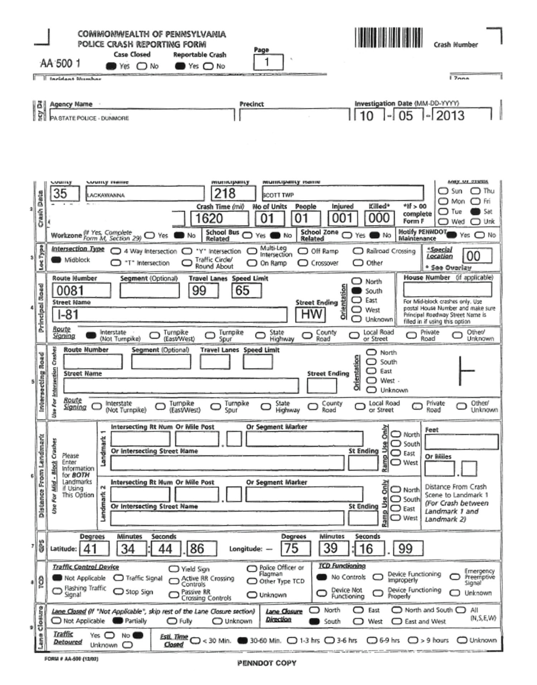

Option 1: Using Crash Reports
Relevant data fields:
  Intersection type.
  Roadway type.
  Traffic control device.
  Crash type.
  Speed limit.
  Illumination type.
  Indicators for:
    Work zone.
    School bus/zone related.
Source: FHWA.

Slide 32
Option 2: Merging Data
Data sources and information are needed as follows:
  Roadway inventory data:
    Facility type.
    Number of lanes.
    Cross-sectional elements.
    Traffic control and speed limit.
  Traffic data:
    Traffic volume.
    Nonmotorized user exposure.
    Traffic composition.
  Crash data:
    Number of crashes by type.
    Number of crashes by severity.
Analysis database must be developed to identify FCFTs.
Each “row” or observation should represent a single crash that was observed.
Each crash observation should be linked to the roadway and traffic characteristics based on where the crash occurred—The linear referencing system can be used.

Slide 33
Polling Question
Q4
Source: FHWA.
Are you familiar with a linear referencing system?
Notes:
Are you familiar with a linear referencing system?
-Yes, I use if often
-Yes, but it’s not something I typically work with
-No, I’ve never heard this term before
-Not sure, I’ve heard this term but not sure what it means

Slide 34
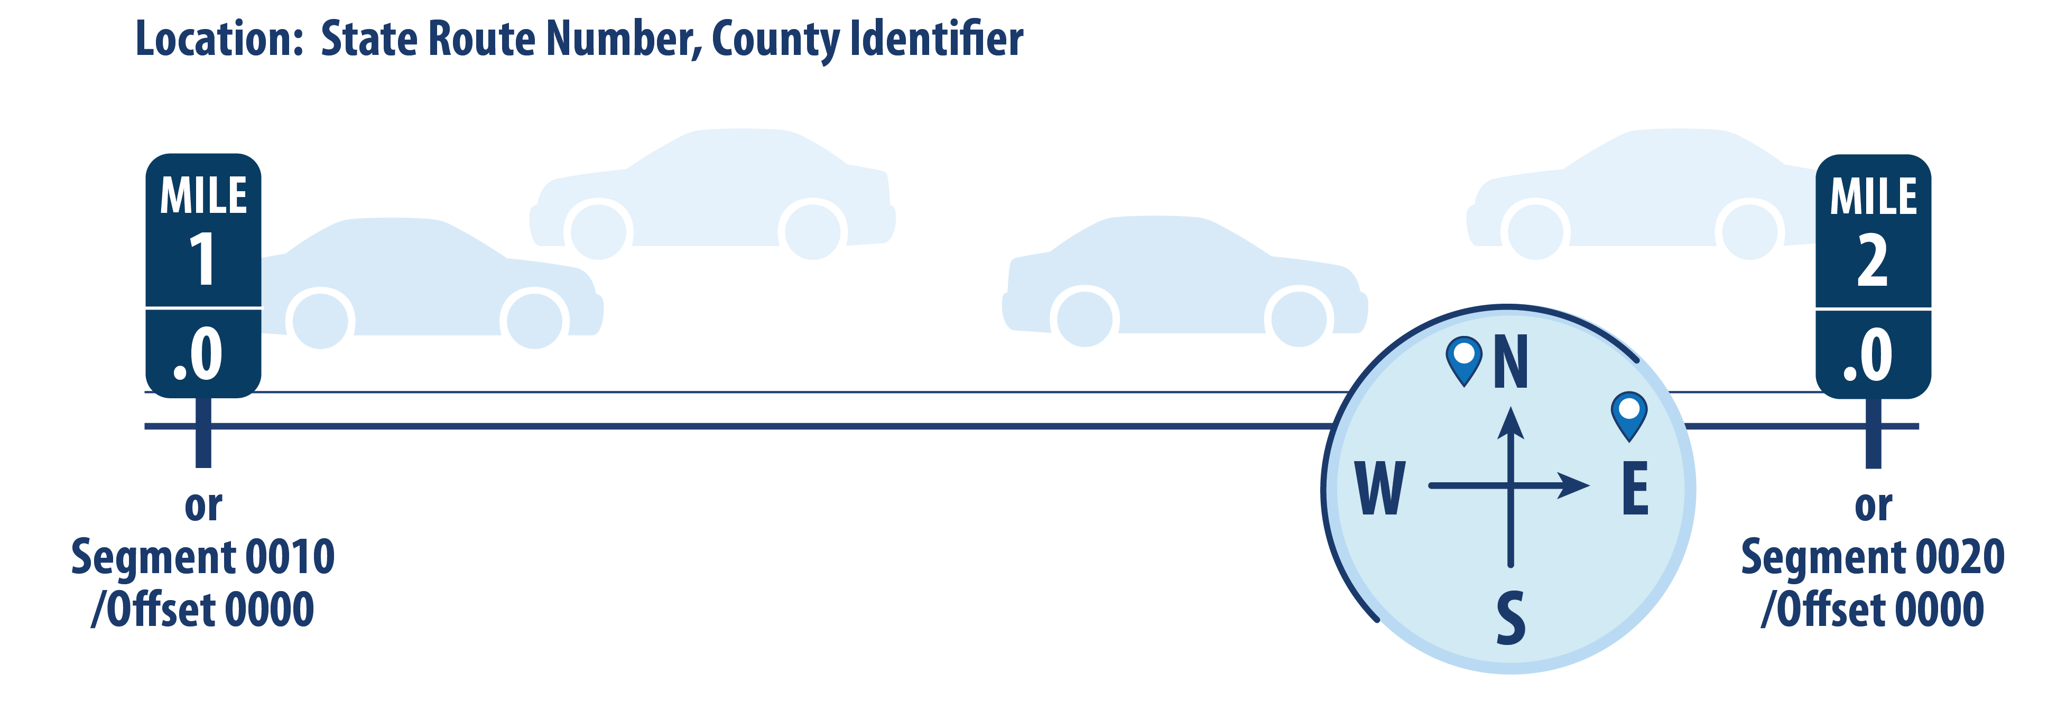
What Is a Linear Referencing System?
Source: FHWA.

Slide 35

Merging Crash and Roadway Data for FCFT Identification
Road Log File
County | Route | Beg_MP | End_MP | Lanes | Lane Width | Shld Width
12 | 322 | 0 | 1.25 | 2 | 12 | 6
12 | 322 | 1.25 | 2.45 | 4 | 11 | 8
12 | 322 | 2.45 | 3.05 | 4 | 12 | 6
12 | 322 | 3.05 | 4.03 | 4 | 11 | 6
Crash File
Crash ID | County | Route | MP | Severity
654 | 12 | 322 | 1.75 | 4
4556 | 12 | 322 | 3.35 | 5
5426 | 12 | 322 | 0.75 | 3
6241 | 12 | 322 | 2.65 | 3
7412 | 12 | 322 | 2.85 | 4
8641 | 12 | 322 | 3.75 | 5
9715 | 12 | 322 | 0.65 | 3
What were the roadway and traffic characteristics associated with each crash?
Beg = beginning; MP = milepost; Shld = shoulder; ID = identification.

Slide 36
Merging Crash and Roadway Data for FCFT Identification
Road Log File
County | Route | Beg_MP | End_MP | Lanes | Lane Width | Shld Width
12 | 322 | 0 | 1.25 | 2 | 12 | 6
12 | 322 | 1.25 | 2.45 | 4 | 11 | 8
12 | 322 | 2.45 | 3.05 | 4 | 12 | 6
12 | 322 | 3.05 | 4.03 | 4 | 11 | 6
Crash File
Crash ID | County | Route | MP | Severity
654 | 12 | 322 | 1.75 | 4
4556 | 12 | 322 | 3.35 | 5
5426 | 12 | 322 | 0.75 | 3
6241 | 12 | 322 | 2.65 | 3
7412 | 12 | 322 | 2.85 | 4
8641 | 12 | 322 | 3.75 | 5
9715 | 12 | 322 | 0.65 | 3
Crash ID | County | Route | MP | Severity | Lanes | Lane Width | Shld Width
654 | 12 | 322 | 1.75 | 4 | 4 | 11 | 8
4556 | 12 | 322 | 3.35 | 5 | 4 | 11 | 6
5426 | 12 | 322 | 0.75 | 3 | 2 | 12 | 6
6241 | 12 | 322 | 2.65 | 3 | 4 | 12 | 6
7412 | 12 | 322 | 2.85 | 4 | 4 | 12 | 6
8641 | 12 | 322 | 3.75 | 5 | 4 | 11 | 6
9715 | 12 | 322 | 0.65 | 3 | 2 | 12 | 6
Notes:
VG question: Do we want to make up another data example where roadway features changed? That might be more helpful to demonstrate the “merge” required in this case?

Slide 37
Analyzing Data for FCFT Identification
Various methods can be used to identify FCFTs:
Computing simple summary statistics and developing crash trees.
  What other methods can be used?

Slide 38
Exercise: Identify FCFTs
Notes:
Conduct a live exercise using real data. Create crash tree from data and ask participants to identify FCFTs

Slide 39
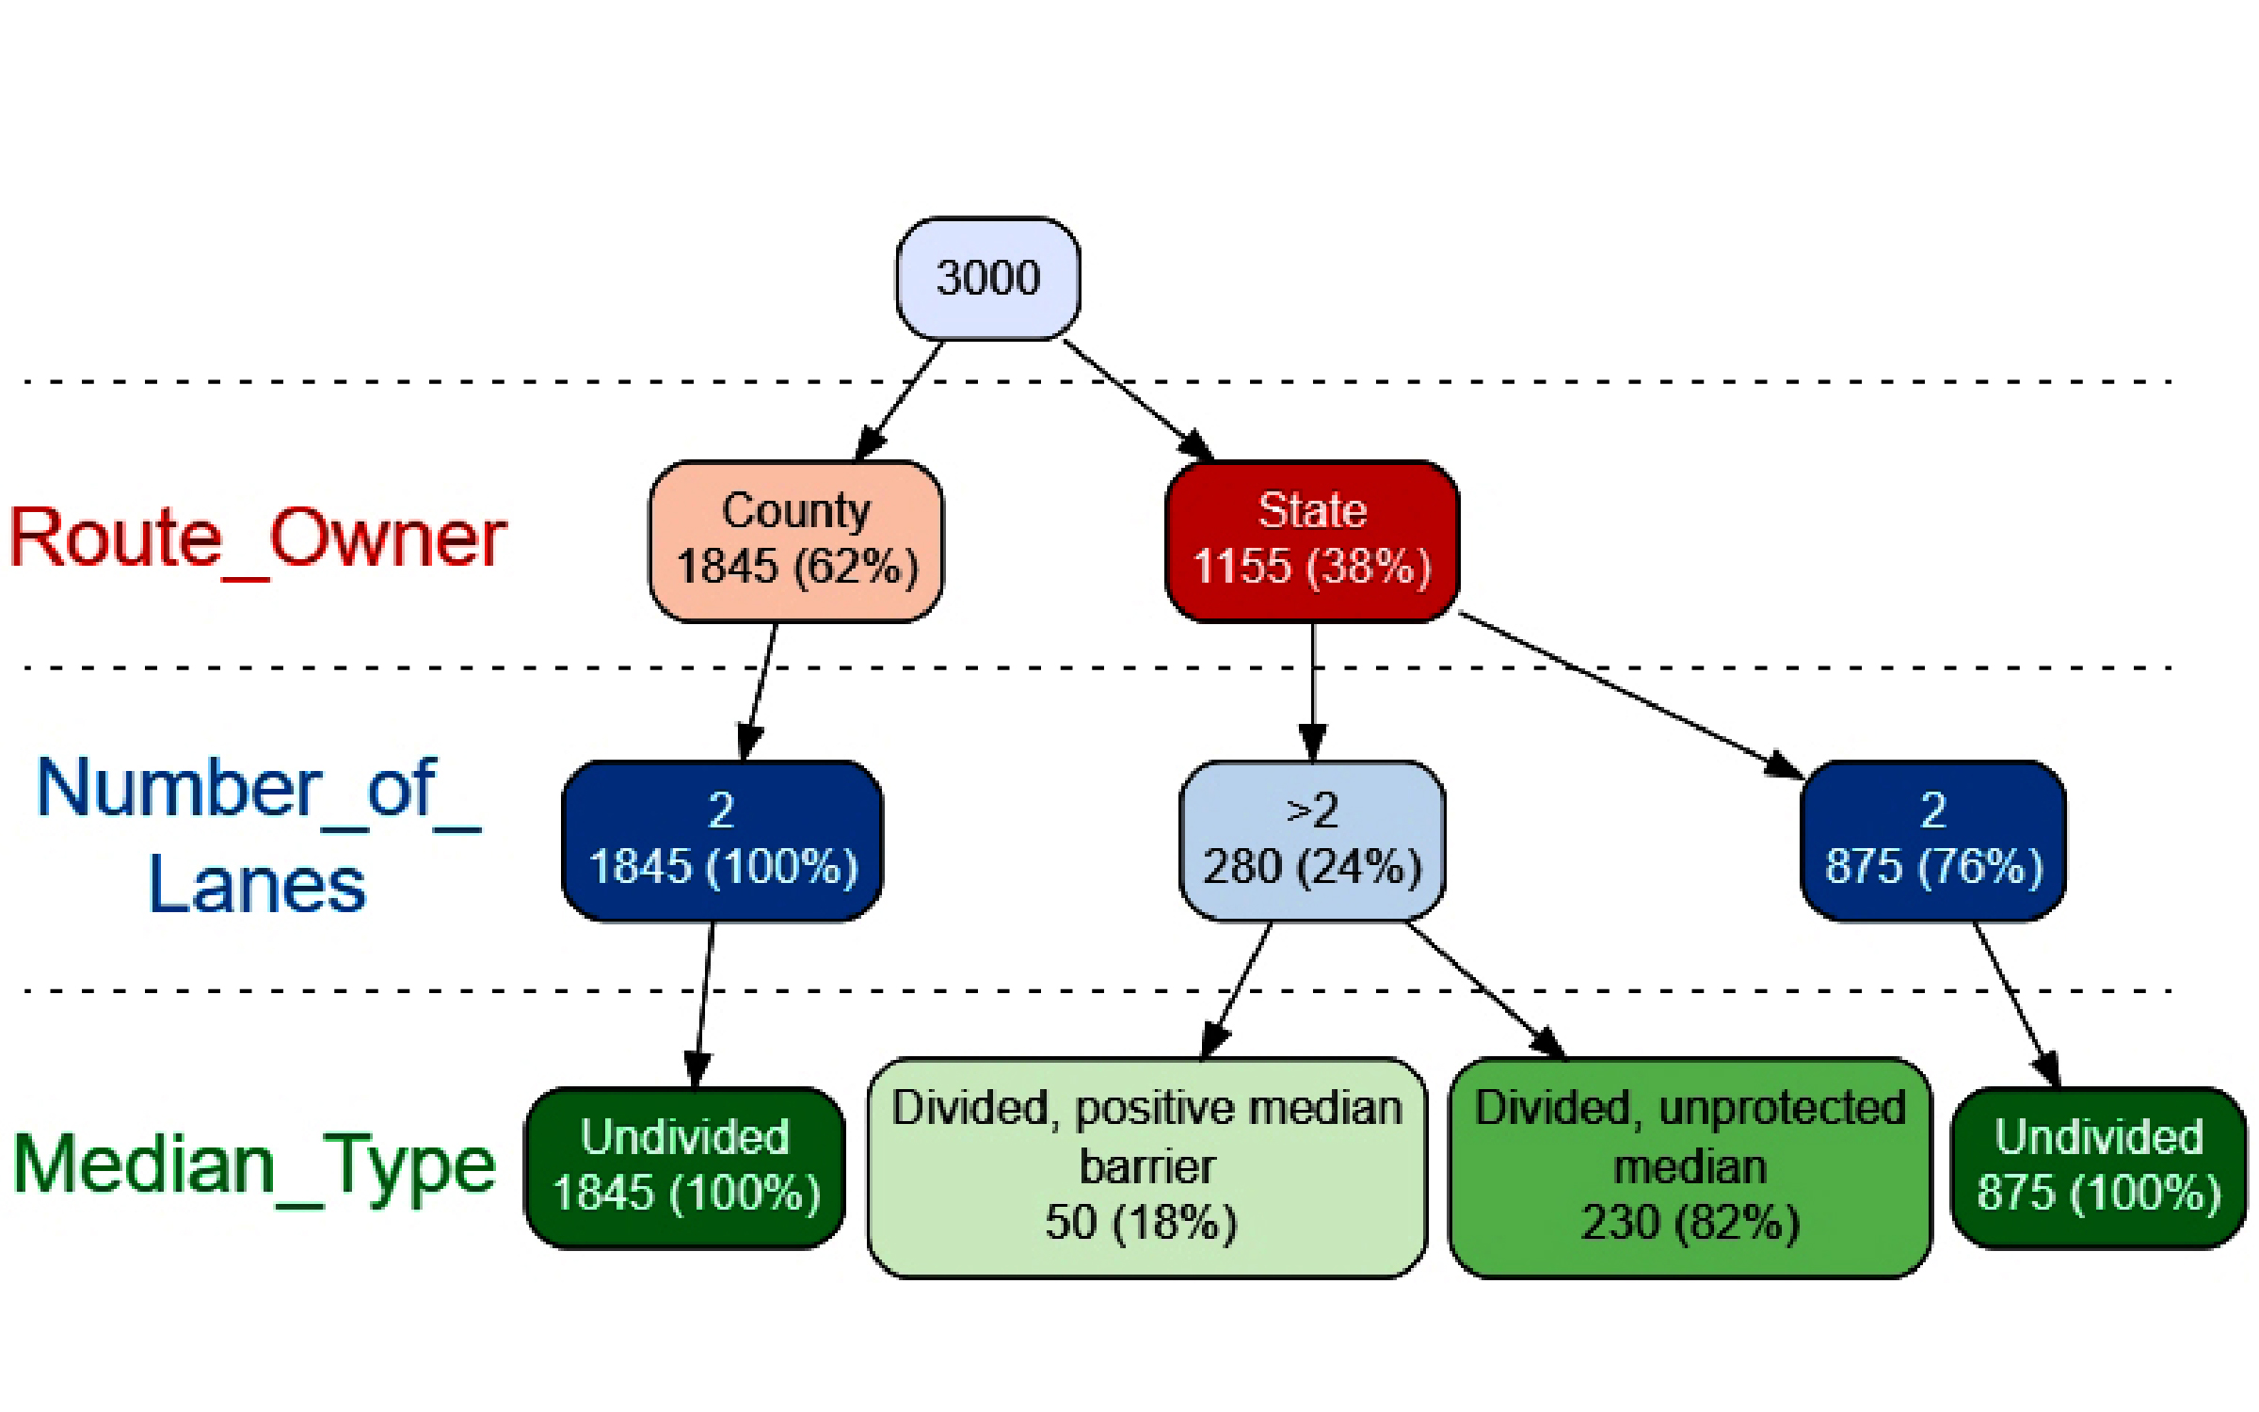
Exercise: Identify FCFTs From Crash Tree
Generate crash tree from data.
Identify FCFTs.
Source: FHWA.
Crash tree generated using R⁽⁷⁾ and vtree package.⁽⁸⁾
Notes:
Conduct a live exercise using real data. Create crash tree from data and ask participants to identify FCFTs

Slide 40
Question
Q5
What are some other methods that could be used for FCFT identification?
Source: FHWA.
Notes:
Open questions for chatbox, follow up with additional discussion on research needs

Slide 41

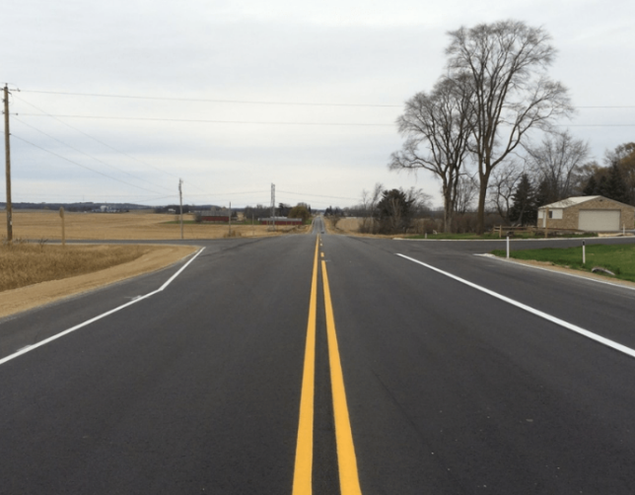
Systemic Approach: Identify and Evaluate Risk Factors
What does “risk factor” mean?
  A representation of risk in terms of the characteristics associated with locations where targeted crash types occurred:
    Traffic volume.
    Roadway geometry (number of lanes, lane width, curvature).
    Traffic operations (speed, traffic control, signs, markings).
    Roadside design (clear zone, sight distance).
All photos source: FHWA.

Slide 42
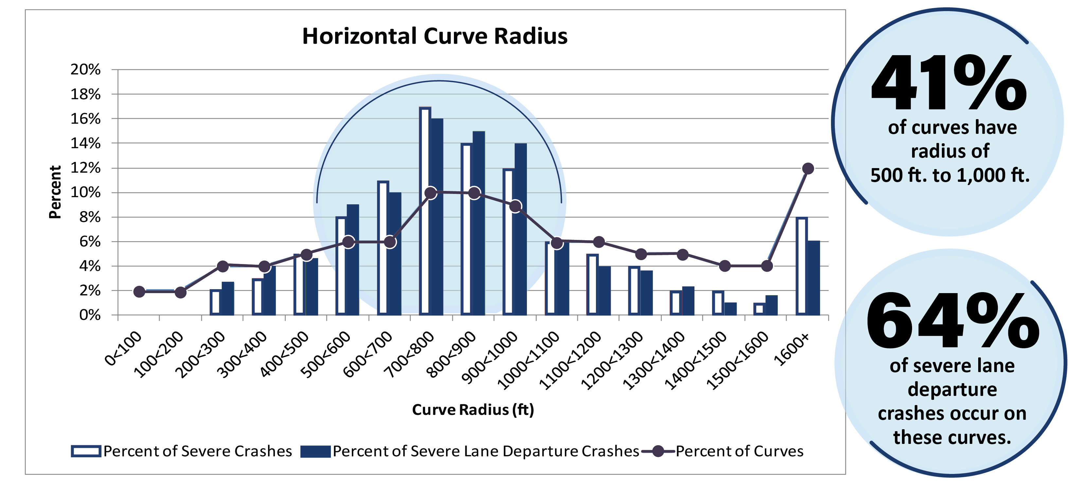
Systemic Approach: Identify and Evaluate Risk Factors
Source: FHWA.

Slide 43
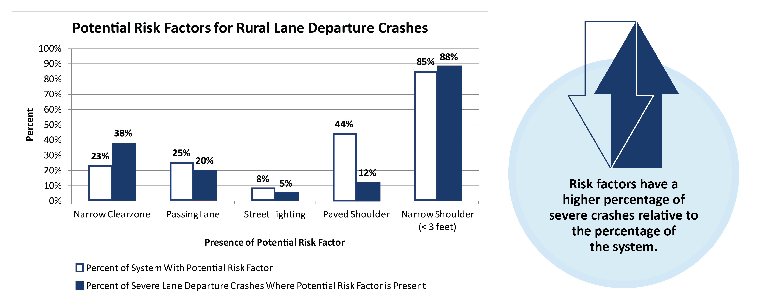
Systemic Approach: Identify and Evaluate Risk Factors
Source: FHWA.

Slide 44

FHWA FCFT Report: Risk Factors
Three States:
  California and Ohio data for non-intersection
  crashes.
  Washington and Ohio data for intersection
  crashes.
Data sources:
  Roadway and traffic data from HSIS.
  Climate data from National Oceanic and Atmospheric Administration.
  Socioeconomic data from U.S. Census Bureau.
Source: FHWA.

Slide 45




FHWA FCFT Report: Risk Factors
Integrate data from different sources:
  Designate plot study locations for each State:
    Intersections.
    Curve segments.
    Tangent segments.
  Join climate data:
    Use nearest weather station.
    Base on straight line distance.
  Join census data:
    Use census block containing study site.
    Use the midpoint for roadway segment.
All art source: FHWA.

Slide 46
FHWA FCFT Report: Risk Factors
Potential contributing factors defined by three categories:
  Roadway.
  Climate.
  Census.
  Philosophy of causation or causal inference not implied:
  Some could be direct contributing factors.
  Others may be surrogates for other characteristics.
  Consistency considered:
  Across subsets of related FCFTs.
  Across multiple States.
  With previous findings in the literature.

Slide 47

FHWA FCFT Report:
Roadway Risk Factors
Annual average daily traffic (AADT) (average, mainline/major, cross street/minor).
Segment length.
Curve radius.
Percent grade.
Grade type.
Shoulder type.
Terrain.
Speed limit.
Width (lane, shoulder, median, and surface).
Truck percentages.
Mainline left-/right-turn channelization.
Cross-street left-/right-turn channelization.
Number of approaches with
left-/right-turn lanes.

Slide 48



FHWA FCFT Report:
Climate Risk Factors
Potential climate contributing factors:
All art source: FHWA.
  Average annual snowfall totals.
  Average annual rainfall totals.
  Average annual maximum and minimum temperatures.
  Average annual winter minimum temperatures.
  Average annual number of days with temperature ≤32℉.

Slide 49
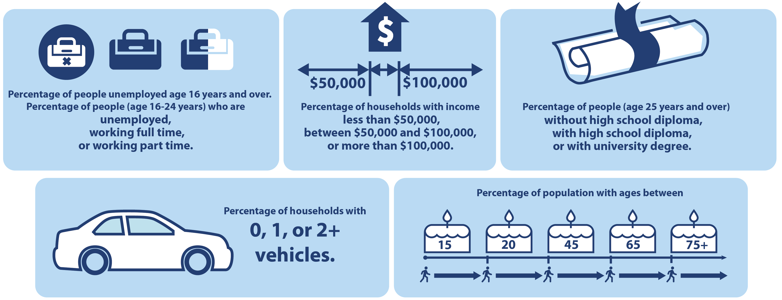
FHWA FCFT Report: Socioeconomic Risk Factors
Source: FHWA.

Slide 50
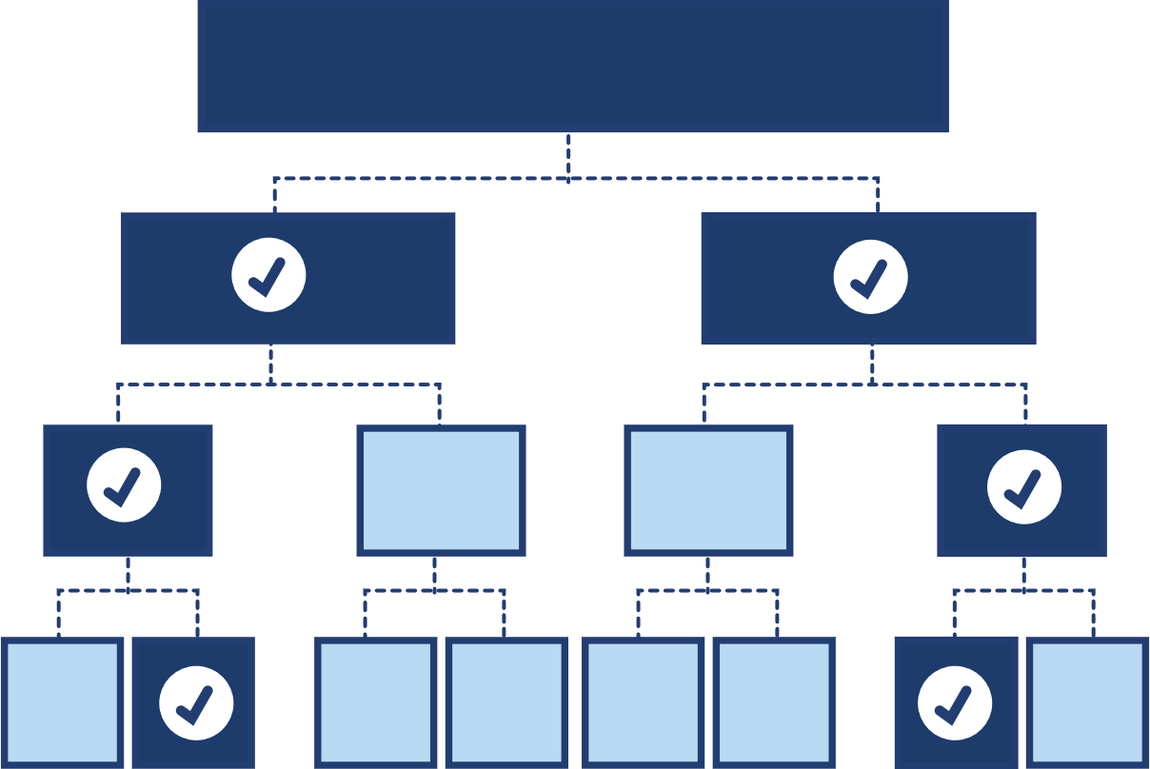
FHWA FCFT Report: Identify Risk Factors
Methodology of random forest:
  Tree-based machine-learning
  algorithm:
    Binary tree mapping a response variable and explanatory variables.
    Output in the form of a tree showing the predictive splits.
  Multiple trees to form a random forest:
    Aggregated results.
    Random forest plots: displaying the increase in mean squared error (MSE) with removal of a variable.
    Most influential variables indicated.
Source: FHWA.

Slide 51
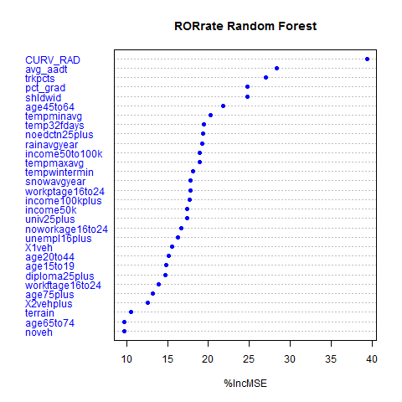
FHWA FCFT Report: Identify Risk Factors
Use the random forest algorithm to identify the strongest predictors (highest percent increase in MSE).
  Example: ROR crashes on rural two-lane horizontal curves.
%IncMSE = percent increase in MSE.
Source: FHWA.⁽¹⁾

Slide 52
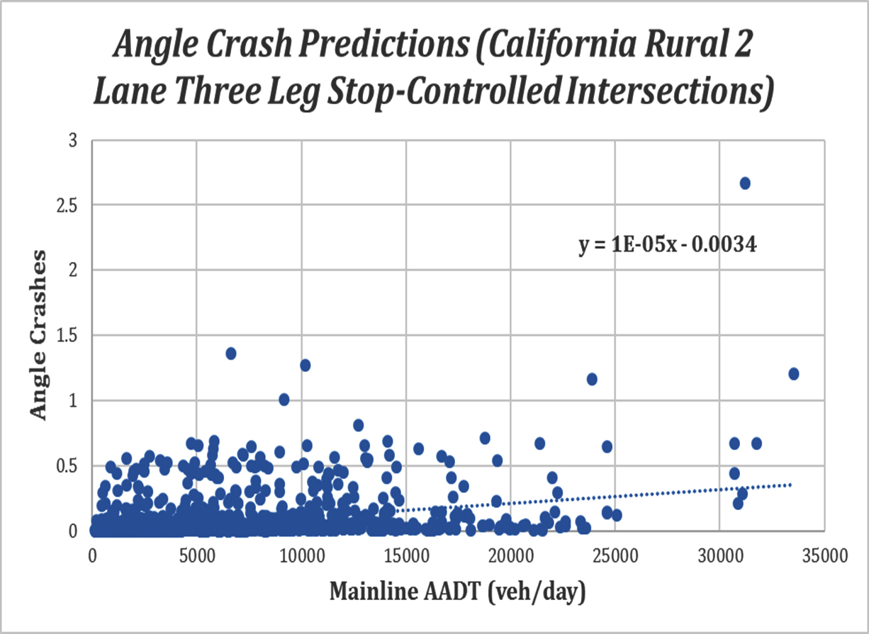
FHWA FCFT Report: Identify Risk Factors
Determine direction of relationship between outcome variable (e.g., crash frequency) and each predictor:
  Plots of random forest predicted crash.
  Example: Angle crashes versus mainline AADT.
Source: FHWA.⁽¹⁾

Slide 53
Shortcomings of the Risk Factor Identification Methods
Random forest plot indicates the importance of variables but does not identify positive (i.e., increase) or negative (i.e., decrease) relationship.
Scatterplot and trendline methods used in the FCFT study are very simplistic methods of identifying the direction of the relationship between each risk factor and crashes.
Better methods need to be developed.

Slide 54
FHWA FCFT Report: Identify Risk Factors
Contributing Factors for Daytime, ROR Crashes That Resulted in Fatal, Incapacitating, or Non-Incapacitating Injury (ROR-KAB-D) on Rural, Two-Lane Tangent Sections: Washington State⁽¹⁾
Variable | Impact on Crash Frequency Predictions
Percent Grade | Increases
Average AADT | Increases
Truck Percentage | Decreases
Average Shoulder Width | Decreases
Average Annual Rainfall Total | Increases
Percentage of Population (Ages 20–44 yr) | Increases
Percentage of People (Ages 16–24 yr) Unemployed | Increases
Annual Average Maximum Temperature | Decreases
Percentage of Population (Ages 25+ yr) with High School Diploma (But No University Degree) | Decreases
Percentage of Population (Ages 25+ yr) without High School Diploma | Decreases

Slide 55
FHWA FCFT Report: Identify Risk Factors
Contributing Factors for Nighttime, Head-on Crashes That Resulted in Fatal, Incapacitating, or Non‐Incapacitating Injury (HEO-KAB-N) on Rural, Two-Lane Horizontal Curves: Washington State⁽¹⁾
Variable | Impact on Crash Frequency Predictions
Percentage of Population (Ages 15–19 yr) | Increases
Truck Percentage | Decreases
Average AADT | Increases
Percentage of Population (Ages 25+ yr) with High School Diploma (But No University Degree) | Decreases
Average Shoulder Width | Increases
Percentage of People (Ages 16–24 yr) Working Part Time | Decreases
Percentage of Households with One Vehicle | Decreases
Percentage of Households with Income > $100,000 | Increases
Annual Average Maximum Temperature | Decreases
Percentage of Population (Ages 65–74 yr) | Decreases

Slide 56
FHWA FCFT Report: Identify Risk Factors
Contributing Factors for Daytime, Angle Crashes That Resulted in Fatal, Incapacitating, or Non‐Incapacitating Injury (ANG-KAB-D) on Rural, Two-Lane Horizontal Curves and Tangent Sections: Ohio⁽¹⁾
Variable | Impact on Crash Frequency Predictions
Percent Grade | Decreases
Average AADT | Increases
Percentage of Population (Ages 25+ yr) with University Degree | Increases
Percentage of Households with Income > $100,000 | Increases
Percentage of Population (Ages 25+ yr) without High School Diploma | Increases
Percentage of Population (Ages 45–64 yr) | Decreases
Surface Width | Increases
Percentage of Population (Ages 25+ yr) with High School Diploma (But No University Degree) | Decreases
Percentage of Population (Ages 20–44 yr) | Increases
Percentage of Population (Ages 75+ yr) | Decreases

Slide 57
FHWA FCFT Report: Identify Risk Factors
Contributing Factors for Daytime, Angle Crashes That Resulted in Fatal, Incapacitating, or Non-Incapacitating Injury (ANG-KAB-D) at Four-Leg Signalized Intersections on Urban, Multilane Divided Roads: California⁽¹⁾
Variable | Impact on Crash Frequency Predictions
Average Annual Rainfall Total | Decreases
Percentage of Households with Income < $50,000 | Increases
Annual Average Winter Minimum Temperature | Decreases
Annual Average Minimum Temperature | Decreases
Annual Average Number of Days with Minimum Temperature ≤ 32℉ | Decreases
Design Speed | Increases
Lane Width | Increases
Percentage of Population (Ages 75+ yr) | Increases
Mainline AADT | Increases
Median Width | Increases

Slide 58
FHWA FCFT Report: Identify Risk Factors
Contributing Factors for Daytime, Angle Crashes That Resulted in Fatal, Incapacitating, or Non-Incapacitating Injury (ANG-KAB-D) at Four-Leg Stop Controlled Intersections on Rural, Multilane Divided Roads: Ohio⁽¹⁾
Variable | Impact on Crash Frequency Predictions
Speed Limit | Decreases
Mainline AADT | Increases
Cross Street AADT | Decreases
Average Annual Snowfall Total | Increases
Annual Average Maximum Temperature | Decreases
Percentage of Households with Income between $50,000 and $100,000 | Decreases
Average Annual Rainfall Total | Increases
Percentage of Households with Income > $100,000 | Increases
Percentage of People (Ages 16–24 yr) Unemployed | Increases
Percentage of Population (Ages 25+ yr) with University Degree | Decreases

Slide 59
Questions
Q6
Do you see anything missing from this list of risk factors?
What are advantages and challenges of weather and socioeconomic factors?
Risk Factors for ROR-KAB-D on Rural, Two-Lane Tangent Road in Washington State
Average AADT
Truck Percentage
Average Shoulder Width
Average Annual Rainfall Total
Percentage of Population (Ages 20–44 yr)
Percentage of People (Ages 16–24 yr) Unemployed
Annual Average Maximum Temperature
Percentage of Population (Ages 25+ yr) with High School Diploma (But No University Degree)
Percentage of Population (Ages 25+ yr) without High School Diploma
Source: FHWA.
Notes:
Open questions for chatbox

Slide 60
What Have We Covered?
Overview of the systemic approach.
Focus crash facility types:
  Overview of FHWA FCFT study.
  Development of agency-specific FCFTs.
Risk factors:
  Identification and evaluation of risk factors.
  Summary of FHWA FCFT study findings.
  After a quick break, a discussion on developing agency-specific risk factors and analysis methods for risk factor identification.
Notes:
Conduct a live exercise using real data

Slide 61

Break
Source: FHWA.
15 min

Slide 62

Quantifying Agency-Specific Risk Factors
Compile data.
Analyze data to quantify
risk factors.
Source: FHWA.

Slide 63
Data Sources
Roadway inventory data—Typically maintained by State and local agencies:
  Facility type.
  Number of lanes.
  Cross-sectional elements.
  Traffic control and speed limit.
Traffic data—Typically maintained by State and local agencies, although some manual counts may be needed:
  Traffic volume.
  Nonmotorized user exposure.
  Traffic composition.
Crash data—Typically maintained by State agencies:
  Number of crashes by type.
  Number of crashes by severity.
All art source: FHWA.

Slide 64

Linking Data
Analysis database represents individual roadway segments/intersections of interest that were identified as an FCFT.
Each “row” or observation should represent a roadway element.
Crashes should be assigned to each roadway element—A linear referencing system can be used.
All art source: FHWA.

Slide 65
Merging Roadway and Crash Data
Use the linear referencing system:
  Find county, route, and MP.
  Start with the road log file as the “base” and append the crash data (must account for segments or intersections with “zero” crash frequency).
Road Log File
Accident File
How many crashes per segment?
Source: HSIS⁽⁶⁾

Slide 66
Data Merge Solution
County-Route | Begin MP | End MP | Number of Crashes
0030000049 | 0 | 0.251 | 0*
0030000049 | 0.251 | 1.42 | 1
0030000049 | 1.42 | 2.03 | 4
0030000049 | 2.03 | 2.13 | 0*
0030000049 | 2.13 | 2.69 | 2
0030000049 | 2.69 | 3.13 | 0*
0030000049 | 3.13 | 3.69 | 1
0030000049 | 3.69 | 4.21 | 0*
0030000049 | 4.21 | 4.503 | 0*
Source: HSIS⁽⁶⁾
*Must retain 0’s

Slide 67

Data Analysis
Risk factors can be quantified using statistical methods. Examples in this workshop include:
  Logistic regression.
  Negative binomial (NB) regression and NB variants.
  Combination of data partitioning and statistical models.
FHWA Highway Safety Statistical Paper Synthesis report includes:⁽²⁾
Alternative data sources and methods for application in safety management process.
  Methods for predication/estimation (e.g., safety performance (SPF) function or risk factor identification) and for evaluation (e.g., crash modification factors (CMFs) or program evaluation).
Source: FHWA^{.(2)}

Slide 68


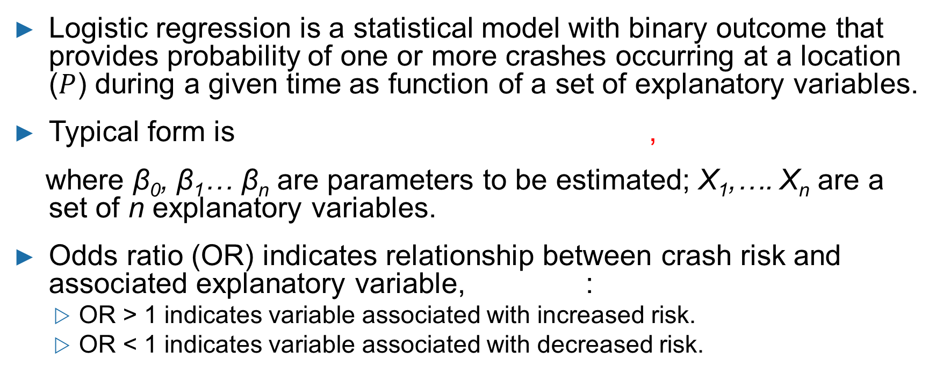
Logistic Regression
Logistic regression is a statistical model with binary outcome that provides probability of one or more crashes occurring at a location ($P$) during a given time as function of a set of explanatory variables.
Typical form is ,
where β₀, β₁… β_{n} are parameters to be estimated; X₁,…. X_{n} are a set of n explanatory variables.
Odds ratio (OR) indicates relationship between crash risk and associated explanatory variable, :
  OR > 1 indicates variable associated with increased risk.
  OR < 1 indicates variable associated with decreased risk.

Slide 69
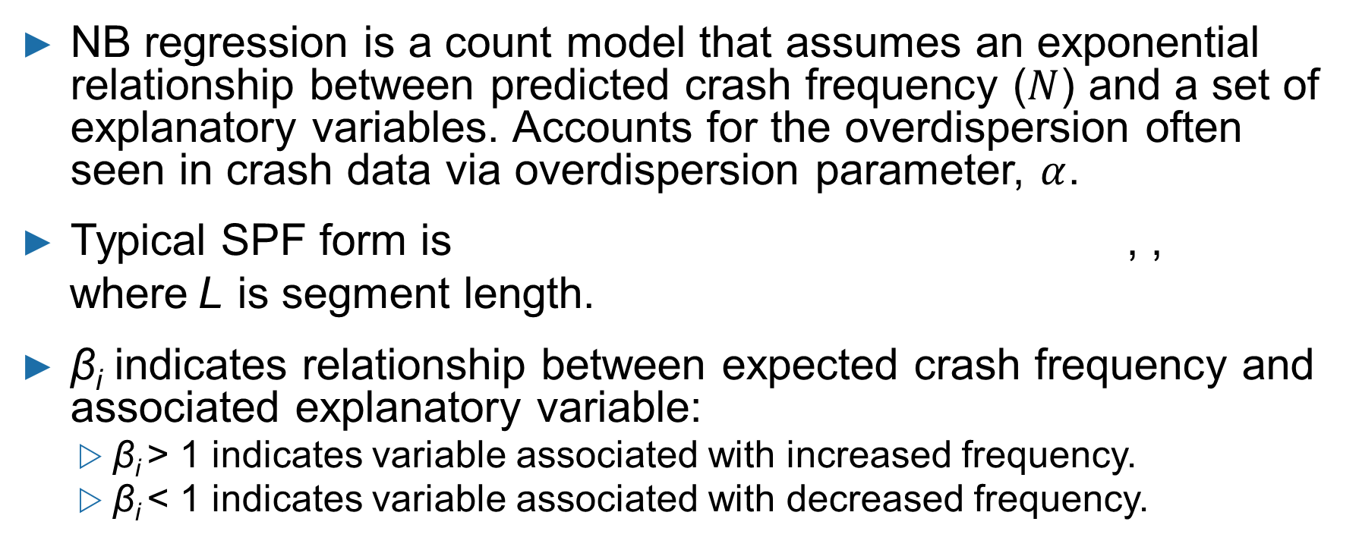
NB Regression
NB regression is a count model that assumes an exponential relationship between predicted crash frequency ($N$) and a set of explanatory variables. Accounts for the overdispersion often seen in crash data via overdispersion parameter, $α$.
Typical SPF form is , ,
where L is segment length.
β_{i} indicates relationship between expected crash frequency and associated explanatory variable:
  β_{i} > 1 indicates variable associated with increased frequency.
  β_{i} < 1 indicates variable associated with decreased frequency.

Slide 70



Extensions to the Traditional NB
Model Have Been Used to Account for Issues in Crash Data
Example issues:
All art source: FHWA.
  NB functional form does not adequately fit crash data.
  Data are temporally and/or spatially correlated.
  Safety-influencing explanatory variables are not available (i.e., unobserved heterogeneity).

Slide 71
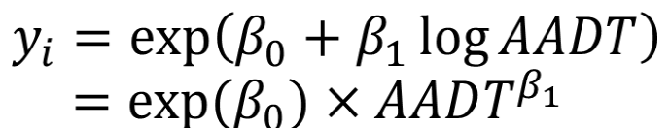


Alternative Model Forms Can Be Used to Improve Fit to Observed Data
Exposure variables are typically entered in log format to yield power function:
Alternate functional forms exist:
  Hoerl form:
  Bifurcated form:
Source: FHWA. Data from Gayah and Donnell.⁽⁹⁾

Slide 72

NB Variations Can be Used to Address Spatial or Temporal Correlation in Data
Crash data are often structured in a “panel” format with repeated observations from a given location over multiple years.
Random-effects models include observation-specific coefficient to capture differences from individual locations.
Where η_{i} is the random-effect parameter.
Segment ID (i) | Crashes in 2016 | Crashes in 2017 | Crashes in year j
001 | 2 | 4 | 0
002 | 0 | 1 | 3
003 | 0 | 3 | 0
004 | 6 | 4 | 3
005 | 4 | 5 | 4
006 | 0 | 1 | 1

Slide 73

Methods That Can Account for Unobserved Heterogeneity
Random parameters formulation: A unique coefficient is estimated for every segment (β_{i,j}).
$β_{i,j}=\overline{β_{J}}$+$φ_{i,j}$
    Where:
    β_{i,j} = j^{th} coefficient applied to segment i.
    β_{J} = mean value for j^{th} coefficient.
    φ_{i,j} = randomly distributed term with known distribution (normal in this case).

Slide 74
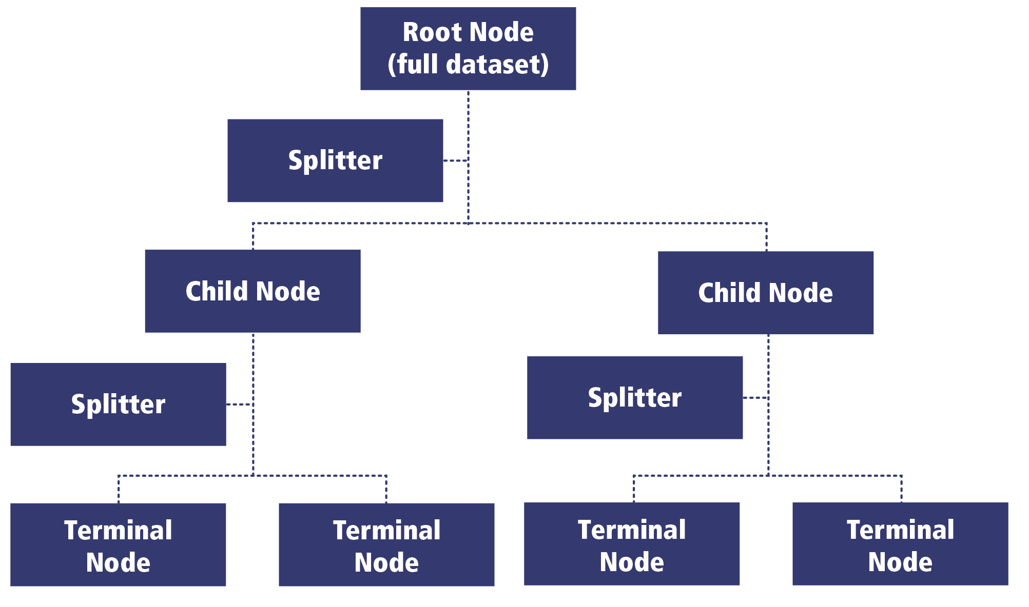
Model-Based Recursive Partitioning (MBRP)
Combines a parametric model (e.g., NB regression) with data splitting to form unique relationships for different
subgroups of the data.
Includes the following steps:
  Fit parametric model to all observations.
  Test coefficient stability over set
  of partitioning variables.
  Split model based on highest parameter instability.
  Repeat procedure until no
  stability is detected.
Source: FHWA. Adapted from Tang and Donnell.⁽¹⁰⁾

Slide 75
Exercise/Demonstration: MBRP
SPF typically provides statistical relationships between observed crash frequency and explanatory variables for a given roadway type.
Variable | Coefficient | P-Value
Intercept | −5.3668 | <0.001
Log(segment length) (mi) | 0.802 | <0.001
Log(AADT) (vehicles/day) | 0.650 | <0.001
Presence of a passing zone (binary) | −0.131 | <0.001
Access density (access points/mi) | 0.011 | <0.001
Curve density (curves/mi) | 0.041 | <0.001
Degree of curvature (degree/100 ft/mi) | 0.001 | <0.001
Example shown here is for two-lane rural roads in Pennsylvania.
Notes:
Conduct a live exercise/demo using real data.

Slide 76
Exercise/Demonstration: MBRP
Crash frequency increases with:
  Segment length.
  Traffic volume.
  Access density.
  Curve density.
  Roadway curvature.
Crash frequency decreases with the presence of a passing zone.
Crash frequency can be used to identify risk factors for locations with potential for safety issues.
Variable | Coefficient | P-Value
Intercept | −5.3668 | <0.001
Log(segment length) (mi) | 0.802 | <0.001
Log(AADT) (vehicles/day) | 0.650 | <0.001
Presence of a passing zone (binary) | −0.131 | <0.001
Access density (access points/mi) | 0.011 | <0.001
Curve density (curves/mi) | 0.041 | <0.001
Degree of curvature (degree/100 ft/mi) | 0.001 | <0.001
Notes:
Conduct a live exercise using real data.

Slide 77
Exercise/Demonstration: MBRP
MBRP can be used to identify more nuanced relationships in a data‐driven way:
  MBRP algorithm is performed where the posted speed limit is used as a potential means to differentiate safety relationships on two-lane rural roads.
  Algorithm identifies different models are needed for low-speed and high‐speed roadway segments.
All two-lane rural roads
Posted speed limit ≤ 40 mph
Posted speed limit > 40 mph
Source: FHWA.
Notes:
Conduct a live exercise using real data.

Slide 78
Exercise/Demonstration: MBRP
MBRP develops unique SPFs for each of these categories.
Low-speed roads (PSL ≤ 40 mph)
High-speed roads (PSL > 40 mph)
Variable | Coefficient | P-Value
Intercept | −5.591 | <0.001
Log(segment length) (mi) | 0.632 | <0.001
Log(AADT) (vehicles/day) | 0.680 | <0.001
Presence of a passing zone (binary) | −0.151 | 0.051
Access density (access points/mi) | 0.009 | <0.001
Curve density (curves/mi) | 0.002 | 0.826
Degree of curvature (degree/100 ft/mi) | 0.001 | <0.001
Variable | Coefficient | P-Value
Intercept | −5.190 | <0.001
Log(segment length) (mi) | 0.916 | <0.001
Log(AADT) (vehicles/day) | 0.635 | <0.001
Presence of a passing zone (binary) | −0.109 | <0.001
Access density (access points/mi) | 0.009 | <0.001
Curve density (curves/mi) | 0.050 | <0.001
Degree of curvature (degree/100 ft/mi) | 0.002 | <0.001
PSL = posted speed limit.
Notes:
Conduct a live exercise using real data.

Slide 79
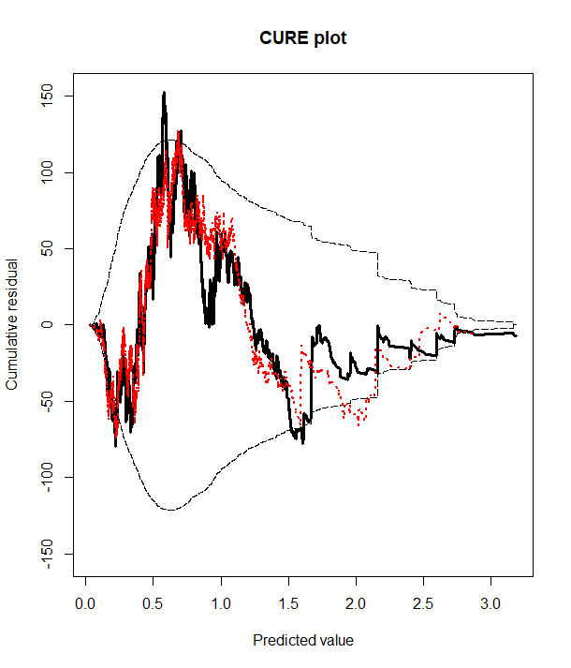
Exercise/Demonstration: MBRP
MBRP also provides a better model fit.
    Black solid – NB model.
    Red dotted – MBRP model.
    Black dashed – two-standard deviation boundaries.
CURE = cumulative residuals.
Graph generated using R⁽⁷⁾ and ggplot2 package.⁽¹¹⁾
Source: FHWA.
Notes:
Conduct a live exercise using real data.

Slide 80
Systemic Approach: Screen and Prioritize Candidate Locations
Rank | Corridor | ADT Range | Road Departure Density | Access Density | Curve Critical Radius Density | Edge Risk | Totals
1 | 144.01 | ★ | ★ | ★ | ★ | ★ | 
2 | 40.04 | ★ | ★ | ★ | ★ | ★ | 
3 | 131.01 |  | ★ | ★ | ★ | ★ | 
4 | 9.02 | ★ | ★ | ★ | ★ |  | 
5 | 5.06 | ★ | ★ | ★ | ★ |  | 
6 | 31.02 | ★ | ★ | ★ | ★ |  | 
7 | 8.01 | ★ | ★ |  |  | ★ | 
8 | 4.01 |  | ★ | ★ |  | ★ | 
9 | 2.05 |  |  | ★ | ★ | ★ | 
Develop a prioritized list:
  Identify
  network elements.
  Conduct risk assessment.
  Prioritize locations.
= risk factor present.
ADT = average daily traffic.
Source: FHWA. Modified by FHWA.⁽⁴⁾

Slide 81
Systemic Approach: Methods of Screening and Prioritizing Candidate Locations
  Common practice: Basic method of ranking and prioritization.
  More rigorous method: Statistical modeling results used to predict risks and rank sites by predicted risk.

Slide 82
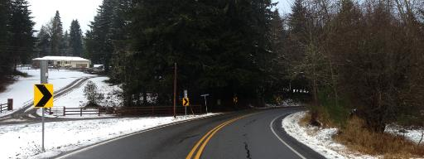
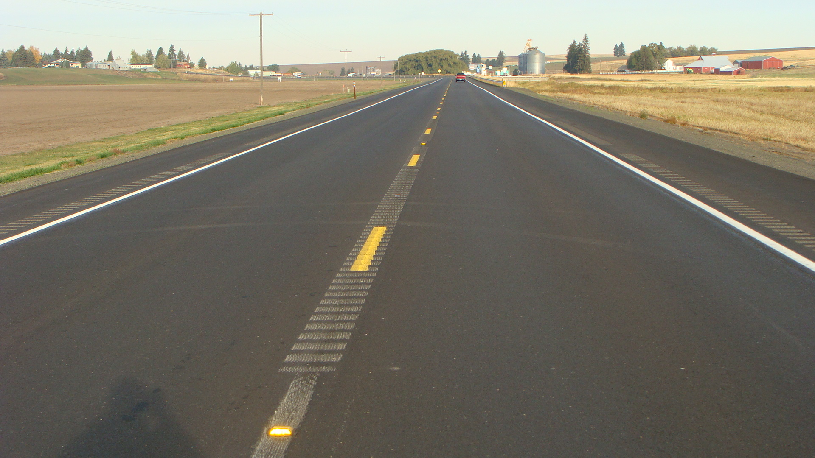
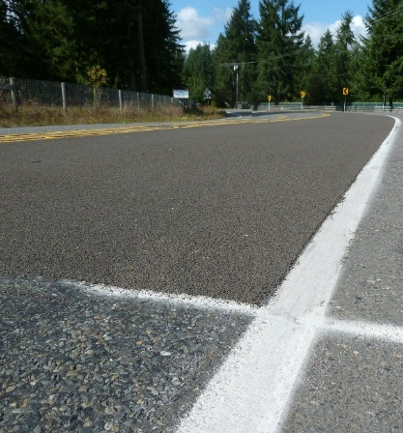
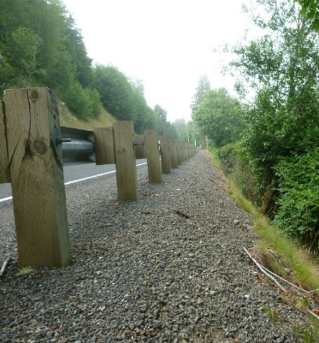
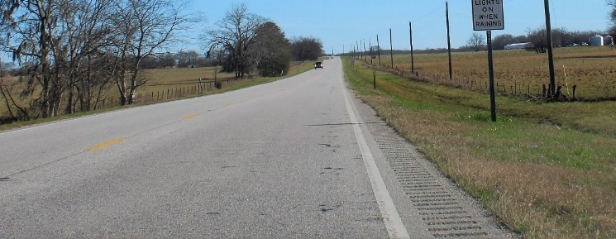
Systemic Approach: Select Countermeasures
  Assemble comprehensive list of countermeasures.
  Evaluate/screen countermeasures.
  Select countermeasures for deployment.
Chevrons
Rumble Strips
Barriers
Clear Zones
High Friction Surface Treatments
All photos source: FHWA.

Slide 83

FHWA FCFT Report: Six-Step Countermeasure Selection
Step 1. Identify focus crash type.
Step 2. Identify contributing factors for focus crash type.
Step 3. Assemble list of potential countermeasures that address the crash type.
Step 4. Identify countermeasures that address the contributing factors associated with the focus crash type.
Step 5. Identify countermeasures with CMFs.
Step 6. Select countermeasure.

Slide 84
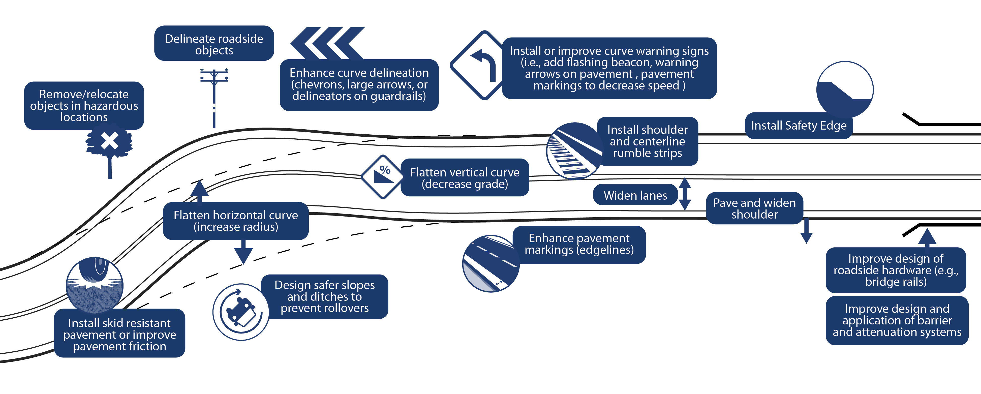
FHWA FCFT Report: Six-Step Countermeasure Selection
Source: FHWA.

Slide 85
Example Countermeasures for Non-Intersection
Countermeasure | Contributing Factor
 | Larger Percent Grade | Narrower Lane Width | Narrower Paved Surface Width | Narrower Shoulder Width | Unpaved Shoulder | Higher Speed Limit | Mountainous Terrain | Smaller Curve Radius
Safety edge | ✓ | ✓ | ✓ | ✓ | ✓ | ✓ |  | ✓
Rumble strips/stripes |  | ✓ | ✓ | ✓ | ✓ | ✓ | ✓ | ✓
Enhanced friction for horizontal curves | ✓ |  | ✓ |  |  | ✓ |  | ✓
Enhanced delineation for horizontal curves |  |  | ✓ |  |  | ✓ |  | ✓
Roadside design improvements at curves |  |  |  |  |  | ✓ |  | ✓
Advance markings for curves |  | ✓ | ✓ | ✓ | ✓ | ✓ |  | ✓
Advance signs |  | ✓ | ✓ | ✓ |  | ✓ | ✓ | ✓
Source: FHWA.⁽¹²⁾
✓ = countermeasure directly addresses risk factor.

Slide 86

FHWA FCFT Report: Summary
Main goal—Inform applications of systemic safety improvements by identifying:
  Focus crash types.
  Focus facility types.
  Associated contributing factors.
Scope—There are three main technical tasks:
  Identify FCFTs—17 FCFTs (9 non-intersection and 8 intersection FCFTs).
  Identify contributing factors associated with the FCFTs.
  Develop a process to select countermeasures.
Source: FHWA.

Slide 87
FHWA FCFT Report: Conclusions, Recommendations
Identifying FCFTs and risk factors:
  Agency with sufficient data and analysis capability:
    Develop agency-specific list of FCFTs.
    Identify risk factors.
  Agency with limited data and analysis capability:
    Refer to Strategic Highway Safety Plan for focus crash types.
    Refer to the FCFT list and risk factors developed from the research.
Source: FHWA.

Slide 88
FHWA FCFT Report: Conclusions, Recommendations
Using random forest to identify contributing factors, there is a limited ability to interpret the direction and form a relationship:
    This research: Simple approach looking for linear trend.
    Recommendation for future work: Exploring more effective ways to uncover the relationship.
Identifying contributing factors using the Bayesian approach shows significant potential—Causal Bayesian networks.
Source: FHWA.

Slide 89
FHWA FCFT Report: Conclusions, Recommendations
Considering socioeconomic and weather factors:
  Potential for supporting informed decisions.
  Not enough theory to support or refute the results.
  More work in this area possibly needed.
Source: FHWA.

Slide 90

Systemic Program Evaluation
CMFs exist to select countermeasures for implementation in systemic safety management process:
  CMFs are often contained in the CMF Clearinghouse.
  Countermeasures are often deployed using the “hot spot” approach.
  Is there any difference in CMF when countermeasure is deployed systemically?
Candidate evaluation methods are:
  Empirical Bayes (EB) before-after.
  Cross-sectional methods.
  Causal inference.
Source: FHWA, CMF Clearinghouse.⁽¹³⁾

Slide 91

EB Method
Use the following evaluation steps:
  Step 1: Develop SPF to predict safety performance of roadways without countermeasure.
  Step 2: Estimate what safety performance of sites should be at sites with countermeasure, had countermeasure not been applied.
  Step 3: Compare estimated and reported safety performance at sites with countermeasure.
Calculate predicted average crash frequency (N_{predict}) using SPF.
Combine reported crash frequency (N_{report}) with predicted crash frequency using EB method:
Where w is the SPF weight, accounting for the accuracy of SPF prediction.

Slide 92
Cross-Sectional Studies
Study a group of sites both with and without the countermeasure.
Combine both treated and untreated sites into one group:
  No major changes should occur within study time frame.
  There is no need to convert from one to the other.
Advantages:
  Larger number of sites with and without countermeasure can usually be identified.
  Countermeasure can be used when not enough before-after information is available.
Disadvantages:
  Sites with and without countermeasure need to be as similar as possible.
  It is difficult to determine if the reason countermeasure was installed is the same at different sites.

Slide 93
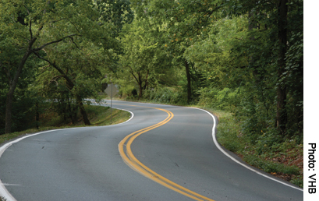
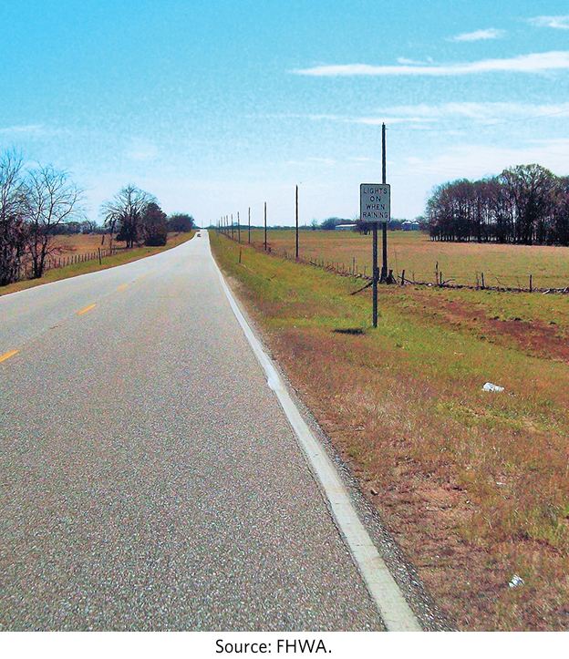
Issues Related to With/Without Samples
A common problem is that the distribution of other characteristics might be different between groups (with and without), which can introduce bias into the model.
A randomized experiment could be performed in other fields to help minimize differences between treatment (with countermeasure) and control (without countermeasure) groups.
Source: FHWA.

Slide 94
Propensity Scores-Potential Outcomes
Propensity score-potential outcome framework, which seeks to “simulate” a randomized experiment using nonrandom data has recently emerged as a solution.
Evaluation steps are as follows:
  Propensity scores used to determine probability that an entity contains treatment of interest based on site-specific conditions (binary logistic regression).
  Treatment observations matched with control observations based on other features and based on probability of a given site receiving treatment.
  Potential outcomes estimated using count regression model.

Slide 95
Concluding Thoughts for Discussion
Are there opportunities to integrate emerging statistical methods into the systemic safety management process?
  Identify target crash types.
  Determine risk factors.
  Evaluate program.

Slide 96
Discussion
Source: FHWA.

Slide 97
Polling Question
Q7
Source: FHWA.
What is one takeaway from today’s presentation that you can use to guide your future research?
Notes:
Insert before summary slide
What is one takeaway, from today’s presentation, that you can use to guide your future research?
-Open response

Slide 98
References
¹ Saleem T., R. Porter, R. Srinivasan, D. Carter, S. Himes, and T. Le. 2020. Contributing Factors for Focus Crash and Facility Types. Report No. FHWA-HRT-20-052. Washington, DC: Federal Highway Administration. https://www.fhwa.dot.gov/publications/research/safety/20052/index.cfm, last accessed October 21, 2021.
² Donnell E., E. Hanks, R. J. Porter, L. Cook, R. Srinivasan, F. Li, M. Nguyen, and K. Eccles. 2020. The Development of Crash Modification Factors: Highway Safety Statistical Paper Synthesis. Report No. FHWA-HRT-20-069. Washington, DC: Federal Highway Administration. https://www.fhwa.dot.gov/publications/research/safety/20069/index.cfm, last accessed October 21, 2021.
³ FHWA. 2016. Electronic Code of Federal Regulations. 23 CFR §924.3 Definitions.
⁴ Preston, H., R. Storm, J. D. Bennett, and B. Wemple. 2013. Systemic Safety Project Selection Tool. Report No. FHWA-SA-13-019. Washington, DC: Federal Highway Administration. https://safety.fhwa.dot.gov/systemic/fhwasa13019/, last accessed October 21, 2021.
⁵ NHTSA. 2018. “Fatality Analysis Reporting System (FARS)” (website). https://www.nhtsa.gov/research-data/fatality-analysis-reporting-system-fars, last accessed January 19, 2018.
⁶ FHWA. n.d. “HSIS” (website). https://www.hsisinfo.org/, last accessed October 21, 2121.
⁷ R Core Team. 2014. R: A language and environment for statistical computing (software). Vienna, Austria: R Foundation for Statistical Computing. http://www.R-project.org/, last accessed October 28, 2021.

Slide 99
References
⁸ Barrowman, N., S. Gatscha, and F. Momoli. 2021. vtree: Display Information About Nested Subsets of a Data Frame (software). https://CRAN.R-project.org/package=vtree, last accessed October 28, 2021.
⁹ Gayah, V., and E. Donnell. 2021. “Estimating safety performance functions for two-lane rural roads using an alternative functional form for traffic volume.” Accident Analysis and Prevention 157: 106173.
¹⁰ Tang, H. and E. T. Donnell. 2019. “Application of a Model-based Recursive Partitioning Algorithm to Predict Crash Frequency.” Accident Analysis and Prevention 132: 105274.
¹¹ Wickham, H., W. Chang, L. Henry, T. L. Pedersen, K. Takahashi, C. Wilke, K. Woo, H. Yutani, and D. Dunnington. 2021. ggplot2: Create Elegant Data Visualisations Using the Grammar of Graphics (software). https://CRAN.R-project.org/package=ggplot2, last accessed October 28, 2021.
¹² Porter, R., T. Le, F. Gross, D. Carter, Saleem T., and R. Srinivasan. 2020. Contributing Factors for Focus Crash and Facility Types: Quick Reference Guide. Report No. FHWA-HRT-20-053. Washington, DC: Federal Highway Administration.
¹³ FHWA. 2018. “CMF Clearinghouse. 2018” (website). https://cmfclearinghouse.fhwa.dot.gov, last accessed November 3, 2021.

Slide 100
Contacts
Roya Amjadi
Roya.Amjadi@dot.gov
Office of Safety Research Development Federal Highway Administration

