Slide 1

HSIP. Get Them Home Safely.
The Highway Safety Improvement Program (HSIP) connects communities and transportation agencies with funding to make safety improvements that reduce fatalities and serious injuries on our nation’s public roadways. The HSIP maximizes safety benefits for all modes by allowing agencies to accelerate the adoption of the most effective transportation safety practices.
Put your HSIP funds to work, and get everyone home safely.
HSIP. Invest in the future. Save lives today.
Photo Source: @Getty Images.

Slide 2

{Insert Header}
{(Refer to agency strategic plans, improvement plans, action plans. State one or more of the following.)
Insert agency objectives or defined performance measure targets or safety goals.}
The Strategy.
{Insert agency safety initiatives/projects that are supported by HSIP and ties into objective(s) listed above.}
The Result.
{Insert}
{X}
{(Specify and quantify the accomplishments of the initiatives/projects by explaining the results with one or more of the following.)
Number of lives saved.
Number of crashes prevented.
Percentage of crashes or fatalities decreased.
Before/after studies.
Benefit/cost ratio.}
{Insert}
{X}
<insert your logo >
Find out which proven treatment could help you save lives.
Source: {Insert your source}
Notes:
Resources:
Below is a list of resources available online, by FHWA, to gather HSIP data and State specific information. You can use these resources to supplement the data and information you already have through your agency and to pinpoint HSIP’s impacts on areas using data-driven analysis and before and after return on investment statistics to demonstrate the effectiveness of safety treatments in reducing fatalities and serious injuries.
HSIP Reporting: https://safety.fhwa.dot.gov/hsip/reports/
Obligation Rates for the Highway Safety Improvement Program: https://safety.fhwa.dot.gov/hsip/gen_info/slorhsip/
MAP-21 and FAST Act Cumulative HSIP Obligation Rates by State
MAP-21 and FAST Act HSIP Funding Transferred to Other Core Apportioned Programs
State Safety Targets & Performance: https://safety.fhwa.dot.gov/hsip/spm/state_safety_targets/
Safety Data Resources: https://safety.fhwa.dot.gov/hsip/spm/data_resources.cfm
Agency specific case studies: https://safety.fhwa.dot.gov/hsip/resources/fhwasa1102/toc.cfm
FHWA Proven Safety Countermeasures: https://safety.fhwa.dot.gov/provencountermeasures/fhwasa18029/

Slide 3

How do we take steps towards a safer future?
Address crashes before they happen.
The Highway Safety Improvement Program (HSIP) is dedicated to reducing fatalities and serious injuries through a comprehensive program of proactive safety improvement projects. Proactive improvements, also known as systemic safety improvements, address geometric and roadway characteristics associated with severe crash types. Proactive improvements, not only mitigate risk at high-crash locations but also prevent future incidents at locations that have not experienced any crashes
With HSIP, you have the power to change the future and save lives. Take action before the crash happens.
HSIP. Take action today to save lives tomorrow.
Photo source: @Getty Images.

Slide 4
{Insert Header}
{(Refer to agency strategic plans, improvement plans, action plans. State one or more of the following.)
Insert agency objectives or defined performance measure targets or safety goals.}
The Strategy.
{Insert agency safety initiatives/projects that are supported by HSIP and ties into objective(s) listed above.}
{XXX actions/countermeasures/plan}
saves
{XX}
LIVES
and prevents
{XX}
INJURIES
The Result.
{(Specify and quantify the accomplishments of the initiatives/projects by explaining the results with one or more of the following.)
Number of lives saved.
Number of crashes prevented.
Percentage of crashes or fatalities decreased.
Before/after studies.
Benefit/cost ratio.}
<Insert your logo >
HSIP. Take action today to save lives tomorrow.
Source: {Insert your source}
Notes:
Resources:
Below is a list of resources available online, by FHWA, to gather HSIP data and State specific information. You can use these resources to supplement the data and information you already have through your agency and to pinpoint HSIP’s impacts on areas using data-driven analysis and before and after return on investment statistics to demonstrate the effectiveness of safety treatments in reducing fatalities and serious injuries.
HSIP Reporting: https://safety.fhwa.dot.gov/hsip/reports/
Obligation Rates for the Highway Safety Improvement Program: https://safety.fhwa.dot.gov/hsip/gen_info/slorhsip/
MAP-21 and FAST Act Cumulative HSIP Obligation Rates by State
MAP-21 and FAST Act HSIP Funding Transferred to Other Core Apportioned Programs
State Safety Targets & Performance: https://safety.fhwa.dot.gov/hsip/spm/state_safety_targets/
Safety Data Resources: https://safety.fhwa.dot.gov/hsip/spm/data_resources.cfm
Agency specific case studies: https://safety.fhwa.dot.gov/hsip/resources/fhwasa1102/toc.cfm
FHWA Proven Safety Countermeasures: https://safety.fhwa.dot.gov/provencountermeasures/fhwasa18029/

Slide 5
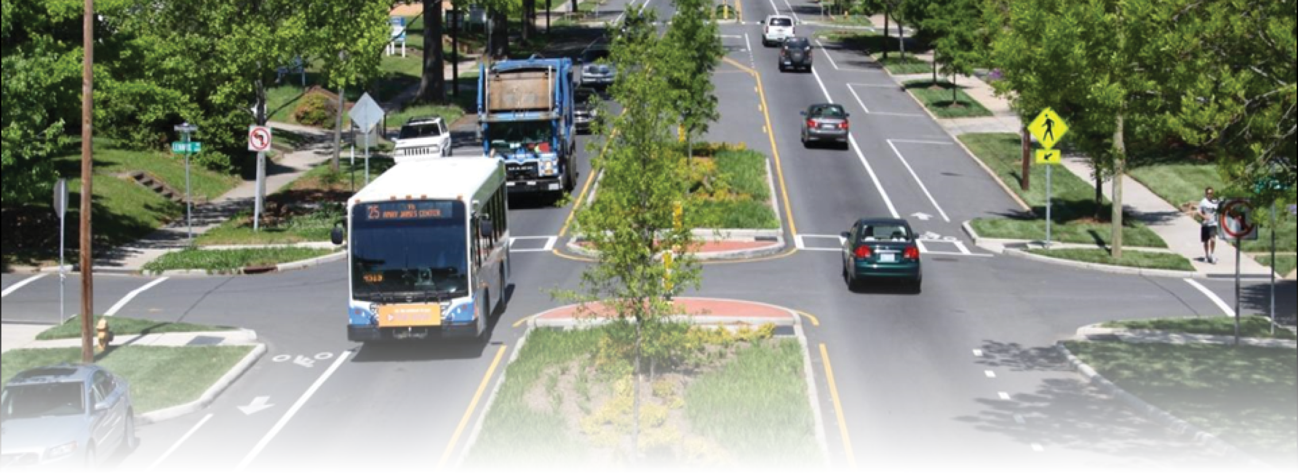
Data + HSIP = Safer Roads.
HSIP is objective, proactive, and consistent - it all adds up.
The Highway Safety Improvement Program (HSIP) provides exclusive funding and guidance for addressing safety issues with science-based, data-driven approaches that help agencies reach both short-term and long-term safety goals.
Leverage your data to diagnose safety issues and to quantify the costs and benefits of safety-related project alternatives. This leads to cost-effective, consistent, and sound investment decisions at the right locations.
Let the data lead you to the issues, and allow HSIP to help you solve them.
HSIP. Today’s data for tomorrow’s roads.
Photo Source: FHWA

Slide 6
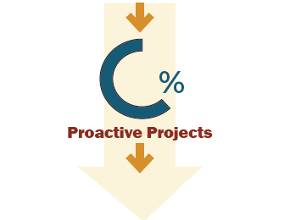
{Insert Header}
{(Refer to agency strategic plans, improvement plans, action plans. State one or more of the following.)
Insert agency objectives or defined performance measure targets or safety goals.}
The Strategy.
{Funding approach,
actions/countermeasures/plan}
{Insert agency safety initiatives/projects that are supported by HSIP and ties into objective(s) listed above.}
The Result.
{X}
{(Specify and quantify the accomplishments of the initiatives/projects by explaining the results with one or more of the following.)
Number of lives saved.
Number of crashes prevented.
Percentage of crashes or fatalities decreased.
Before/after studies.
Benefit/cost ratio.}
{XX %}
{Decrease in Fatalities/ Fatality Rate/Injuries etc.}
<Insert your logo >
Use data to invest your HSIP funds effectively.
Source: {Insert your source}
Notes:
Resources:
Below is a list of resources available online, by FHWA, to gather HSIP data and State specific information. You can use these resources to supplement the data and information you already have through your agency and to pinpoint HSIP’s impacts on areas using data-driven analysis and before and after return on investment statistics to demonstrate the effectiveness of safety treatments in reducing fatalities and serious injuries.
HSIP Reporting: https://safety.fhwa.dot.gov/hsip/reports/
Obligation Rates for the Highway Safety Improvement Program: https://safety.fhwa.dot.gov/hsip/gen_info/slorhsip/
MAP-21 and FAST Act Cumulative HSIP Obligation Rates by State
MAP-21 and FAST Act HSIP Funding Transferred to Other Core Apportioned Programs
State Safety Targets & Performance: https://safety.fhwa.dot.gov/hsip/spm/state_safety_targets/
Safety Data Resources: https://safety.fhwa.dot.gov/hsip/spm/data_resources.cfm
Agency specific case studies: https://safety.fhwa.dot.gov/hsip/resources/fhwasa1102/toc.cfm
FHWA Proven Safety Countermeasures: https://safety.fhwa.dot.gov/provencountermeasures/fhwasa18029/

